Slide 1




SIERRA LEONE RAPID HEALTH FACILITY ASSESSMENT
Summary Report: Round 1
March 2026

Slide 2
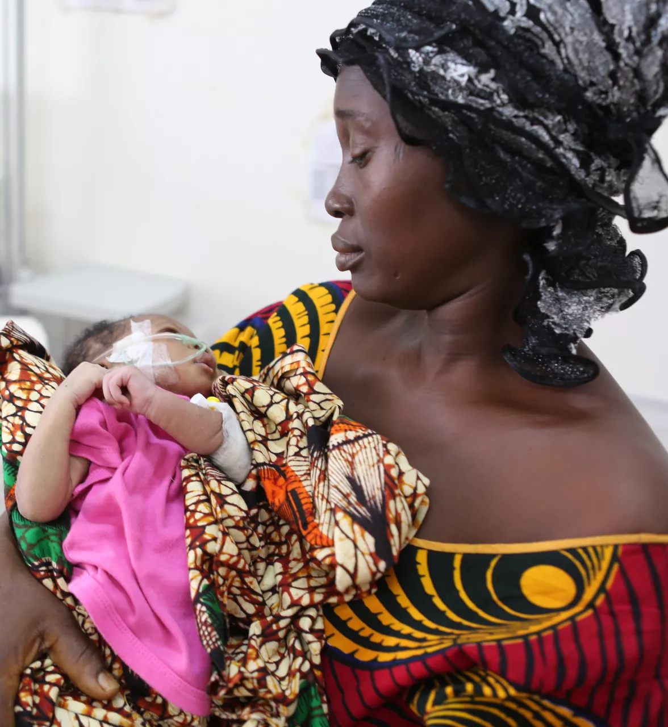
Contents
Overview
Primary Health Care (PHC) Assessment
Service Delivery Challenges
Service Availability
Infrastructure
Medical Supplies
Annex
Methodology Annex
Annex Tables
Background on the FASTR initiative
@ UNICEF Sierra Leone/2016/Mason

Slide 3

1. Overview
Notes:
Quel est l’objectif de FASTR ? L’idée de FASTR est que les analyses à cycle rapide peuvent accélérer les améliorations en matière de santé et de nutrition reproductive, maternelle, néonatale, infantile et des adolescents en favorisant une utilisation systématique des données pour la prise de décision. Actuellement, de nombreux pays dépendent d’enquêtes à grande échelle, réalisées en présentiel, très coûteuses, et qui ne sont menées que tous les 4 à 5 ans — voire moins fréquemment. Bien que ces enquêtes restent importantes, l’objectif de FASTR est de les compléter par une collecte de données plus rapide et régulière. En générant des informations en temps utile entre les grandes enquêtes, nous pouvons mieux suivre les progrès, identifier les défis et ajuster les programmes et politiques de manière plus agile et réactive.

Slide 4

Objectives and Approach
In Sierra Leone, the Ministry of Health with support from the Global Financing Facility for Women, Children, and Adolescents (GFF) and the World Bank, is implementing a series of rapid phone surveys of primary health care facilities under the FASTR initiative.
Objectives:
Provide up-to-date snapshots of primary health care (PHC) facility performance, enabling the rapid identification of critical gaps and service delivery readiness challenges at both national and subnational levels.
Support continuous monitoring of program and reform implementation, facilitating timely course-correction and evidence-based decision-making – ultimately strengthening PHC systems and improving reproductive, maternal, newborn, child, and adolescent health and nutrition (RMNCAH-N) outcomes.
Implementation:
Overall leadership, tool adaptation, and implementation are led by the Ministry of Health.
Data collection was conducted by NOIPolls.
No ethical approval was obtained; The Ministry of Health provided an authorization letter for the assessment.
One round of survey was completed in 2026. 3 quarterly rounds are planned throughout 2026.
Plus de détails sur la méthodologie sont disponibles sur GitHub (https://fastr-analytics.github.io/fastr-resource-hub/).
Notes:
So, the objective of the HFA is to: [read slide]
Implementation: The overall leadership…[read slide]
One round of data collection has been completed thus far and three additional rounds are planned for 2026

Slide 5
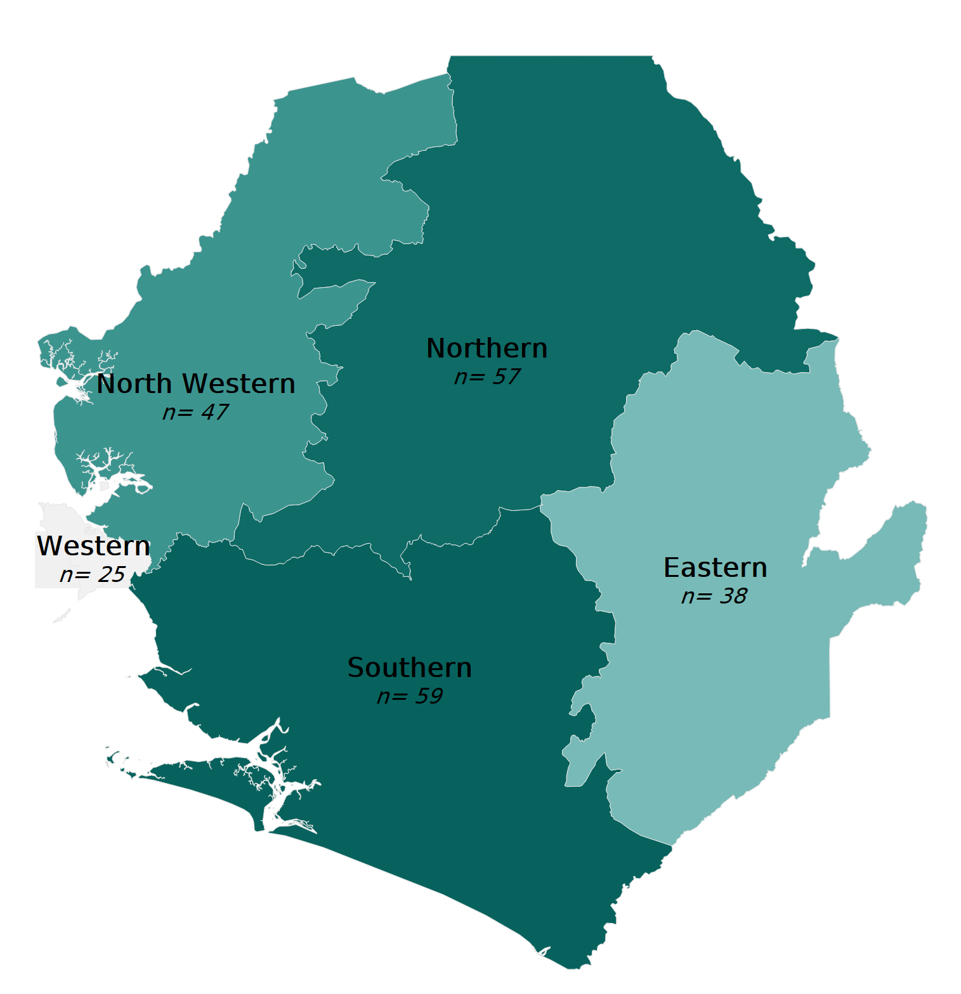


Methodology
Questionnaire :
Focuses primarily on PHC service readiness: availability of critical infrastructure, medical supplies, trained staff, and services provided; but also covers facility governance, community engagement, and recent external “shocks” affecting service delivery.
The tool was adapted to the local context by the Ministry of Health and the World Bank/GFF.
Sampling :
Nationally and regionally representative panel sample of 365 public PHC facilities – including Community Heath Centers (CHC), Community Heath Posts (CHP), District Hospitals (DH), and Maternal and Child Healthcare Posts (MCHP).
Sample stratified by facility type and region.
Surveyed individual: phone interviews with health facility manager.
Survey Sample
Distribution (Round 1)
DH | 7 (2%)
CHC | 95 (26%)
CHP | 127 (35%)
MCHP | 134 (36%)
Round 1
03 Dec 2025-02 Feb 2026
43-48 min
Average call duration
Note : N corresponds to the total number of surveyed facilities in each administrative region. 365 facilities surveyed in round 1.

Slide 6
Survey structure: Adaptative content
Survey Module | Round 1 | Round 2 | Round 3 | Round 4
Health Facility Characteristics | ✅ | ✅ | ✅ | ✅
ADAPTATIVE CONTENT*
Recent Service Delivery Challenges | ✅ | ✅ | ✅ | ✅
Medical Supplies and Equipment | ✅ | ✅ | ✅ | ✅
Service Availability | ✅
Financing |  | ✅
Community Engagement |  | ✅
Infrastructure |  |  | ✅
Quality Improvement Processes |  |  | ✅
Human Resources |  |  |  | ✅
Leadership & Coordination |  |  |  | ✅
To ensure comprehensive data collection without excessively lengthening calls, some modules - those covering service readiness aspects that are unlikely to change significantly over time - are administered only once per year. Other high-variability domains are repeated in every survey round.
*Adaptive content: Additional locally-relevant questions identified based on previous round’s responses, or addressing newly emerging priority topics.
Notes:
The survey will be completed over 4 quarterly survey rounds. The two darker green domains at the top are asked about each round. The items in the lighter green at the bottom of the graph are asked about once annually.
To date, we have completed Round 1. For the first round of the survey, questions were asked about recent service delivery challenges, medical supplies/equipment, service availability and a couple of questions that are asked per quarter about electricity, water, telephone and internet service availability.

Slide 7
2. Primary Health Care Assessment
Notes:
Quel est l’objectif de FASTR ? L’idée de FASTR est que les analyses à cycle rapide peuvent accélérer les améliorations en matière de santé et de nutrition reproductive, maternelle, néonatale, infantile et des adolescents en favorisant une utilisation systématique des données pour la prise de décision. Actuellement, de nombreux pays dépendent d’enquêtes à grande échelle, réalisées en présentiel, très coûteuses, et qui ne sont menées que tous les 4 à 5 ans — voire moins fréquemment. Bien que ces enquêtes restent importantes, l’objectif de FASTR est de les compléter par une collecte de données plus rapide et régulière. En générant des informations en temps utile entre les grandes enquêtes, nous pouvons mieux suivre les progrès, identifier les défis et ajuster les programmes et politiques de manière plus agile et réactive.

Slide 8
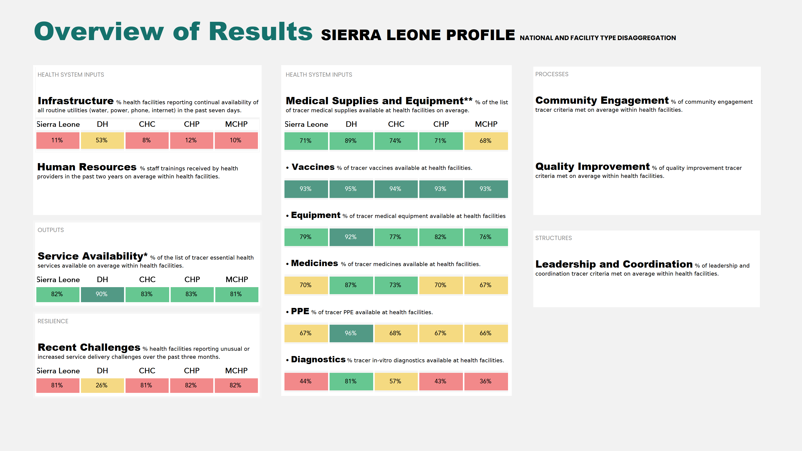
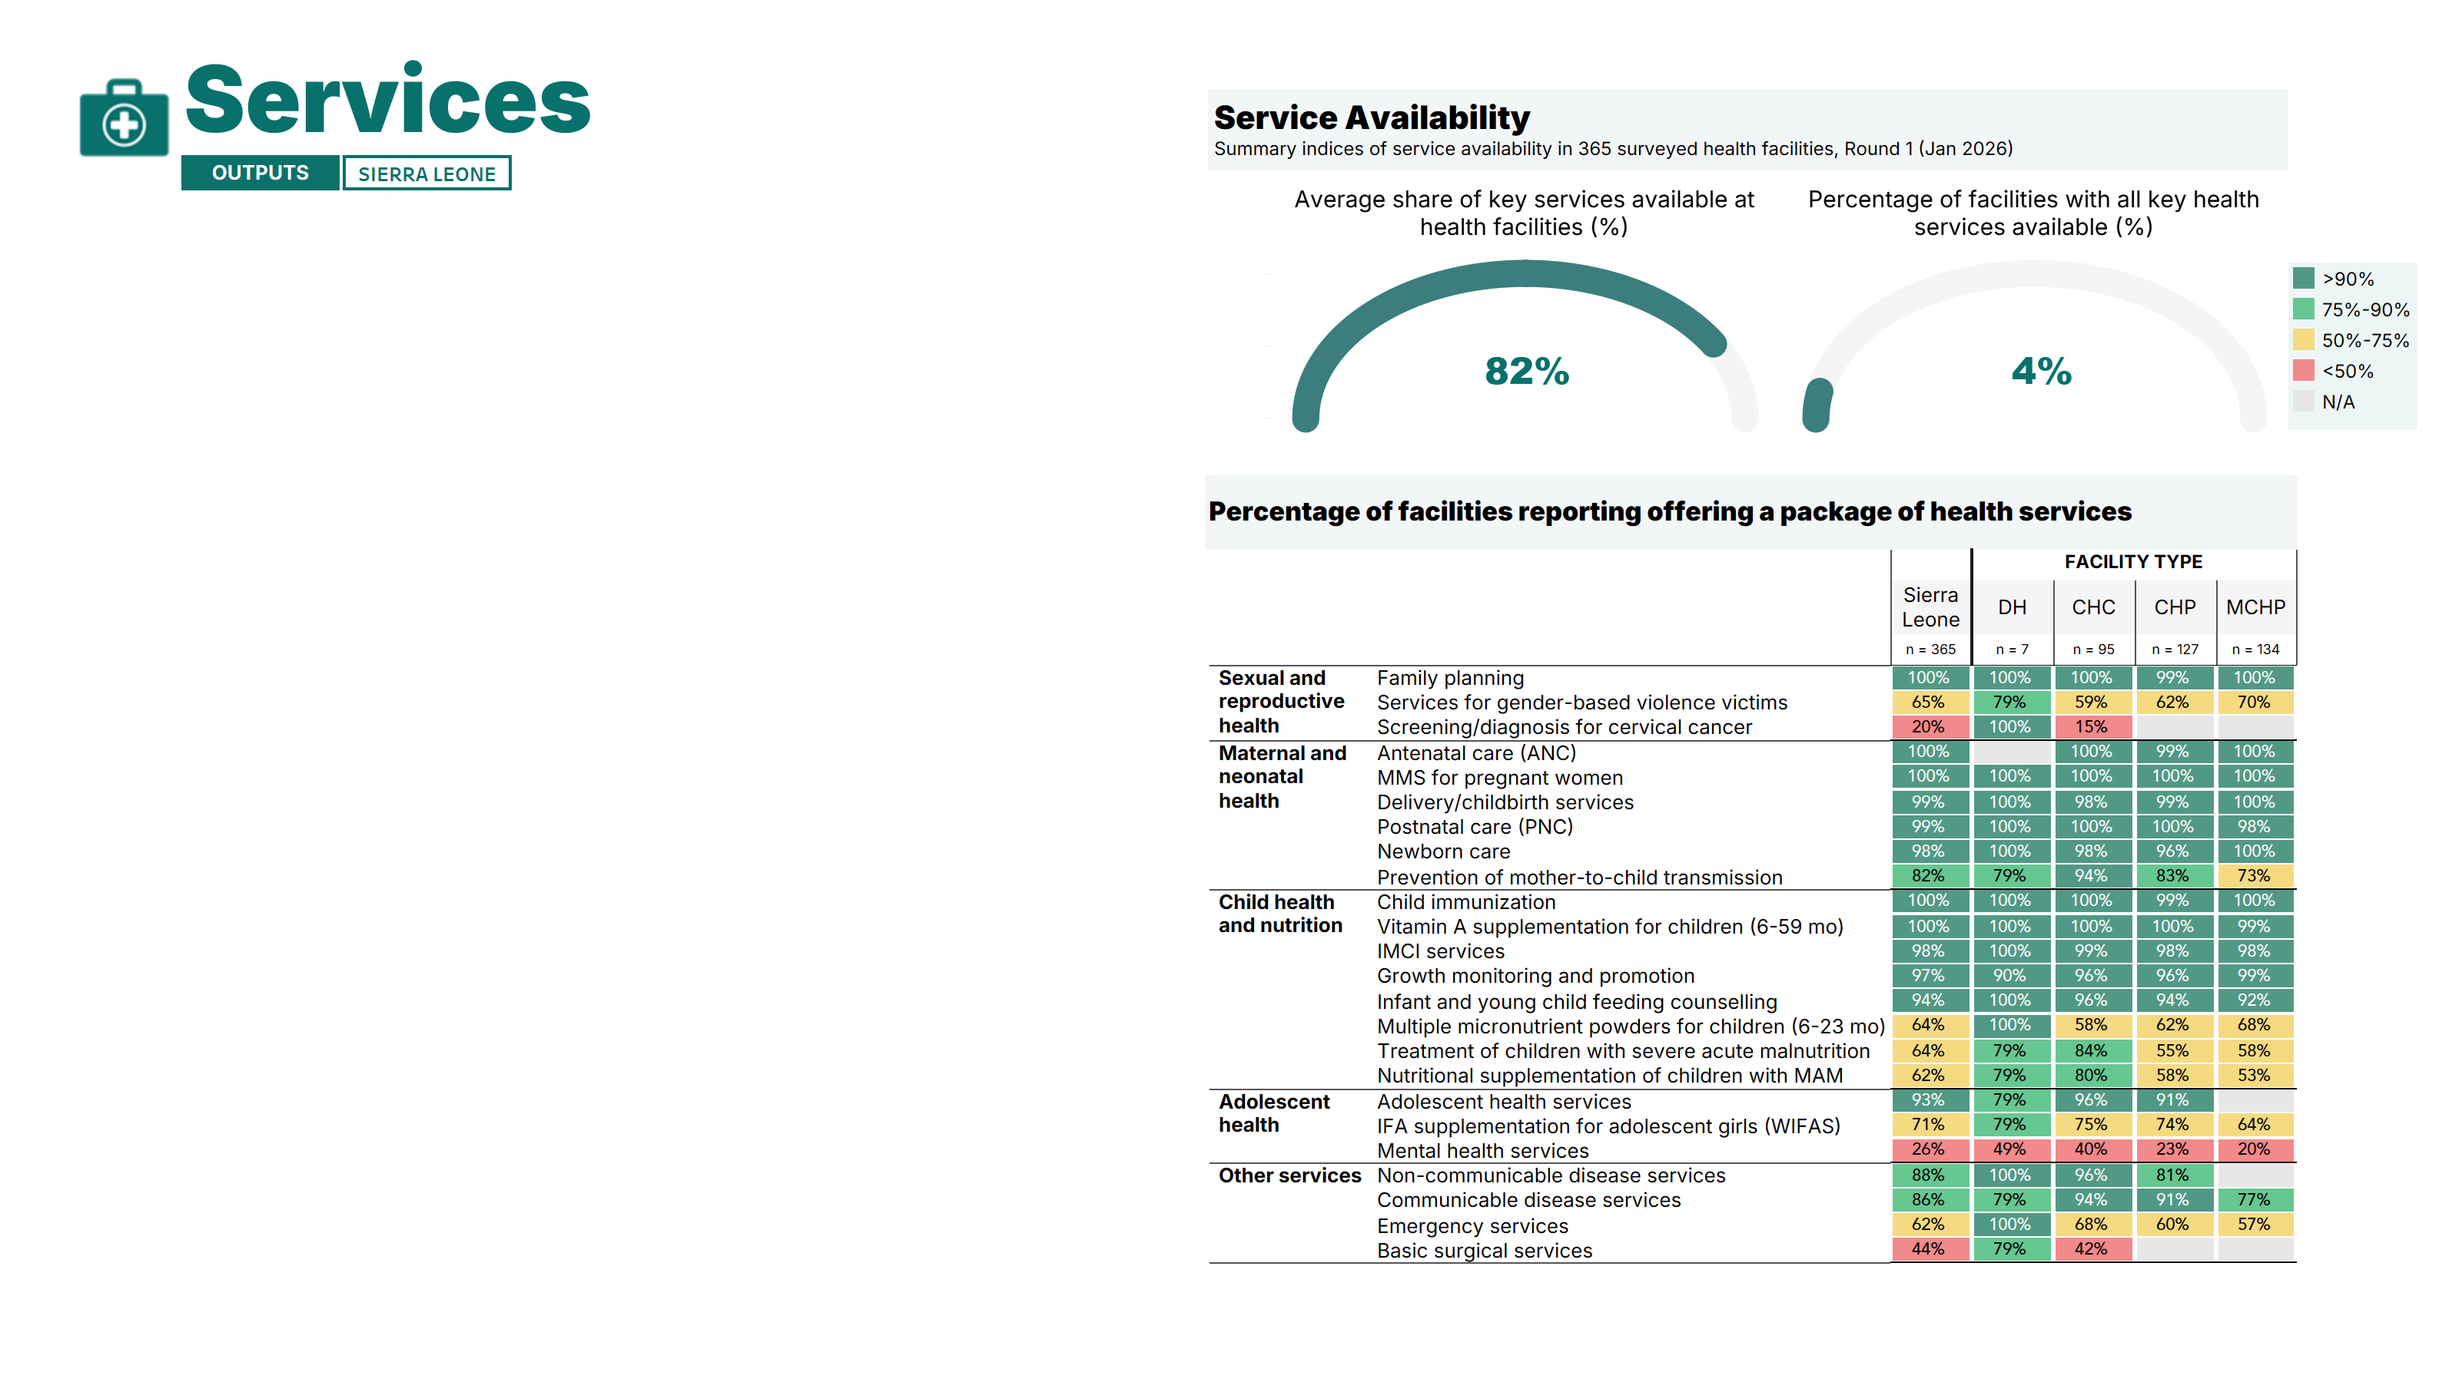
- Upcoming Round 2 -
- Upcoming Round 4 -
- Upcoming Round 3 -
- Upcoming Round 4 -
Note: The color coding is reversed for the “recent challenges” indicator: green ≤10%, yellow 11–39%, and red ≥40% **List of tracer essential health services: The complete list of 24 tracer services included in the survey and presented in this report.
***List of tracer medical supplies: The complete list of 48 tracer medical supplies included in the survey and presented in this report. Details on the specific items and index calculation methodology are provided in the Methodological Annex.
Notes:
This slide provides a high-level snapshot of health system performance in Sierra Leone, disaggregated by facility type. And here, we’ll see data from the areas that were asked about for this round. Other domain results will be added once those modules are included in subsequent rounds.
Starting with infrastructure, availability of basic utilities is a major gap. Only 11% of facilities nationwide report consistent access to water, power, phone, and internet. This is particularly low in CHC, CHP and MCHP facilities, highlighting disparities across facility types.
Service availability is relatively high with facilities providing 82% of the services that were asked about in the survey.
A large proportion of facilities, 81% overall, report recent service delivery challenges. Interestingly, this is much lower in district hospitals at 26%, but very high across other facility types.
And then on supplies and equipment, performance is mixed. Vaccines are a strong area, with over 90% availability across all facility types. Medicines and PPE are more variable, generally ranging from about 66% to the 90s depending on facility type. Equipment availability drops further, especially in lower-level facilities. Diagnostics is the weakest area with only 44% availability in Sierra Leone, and as low as 36% in the MCHP facilities.

Slide 9
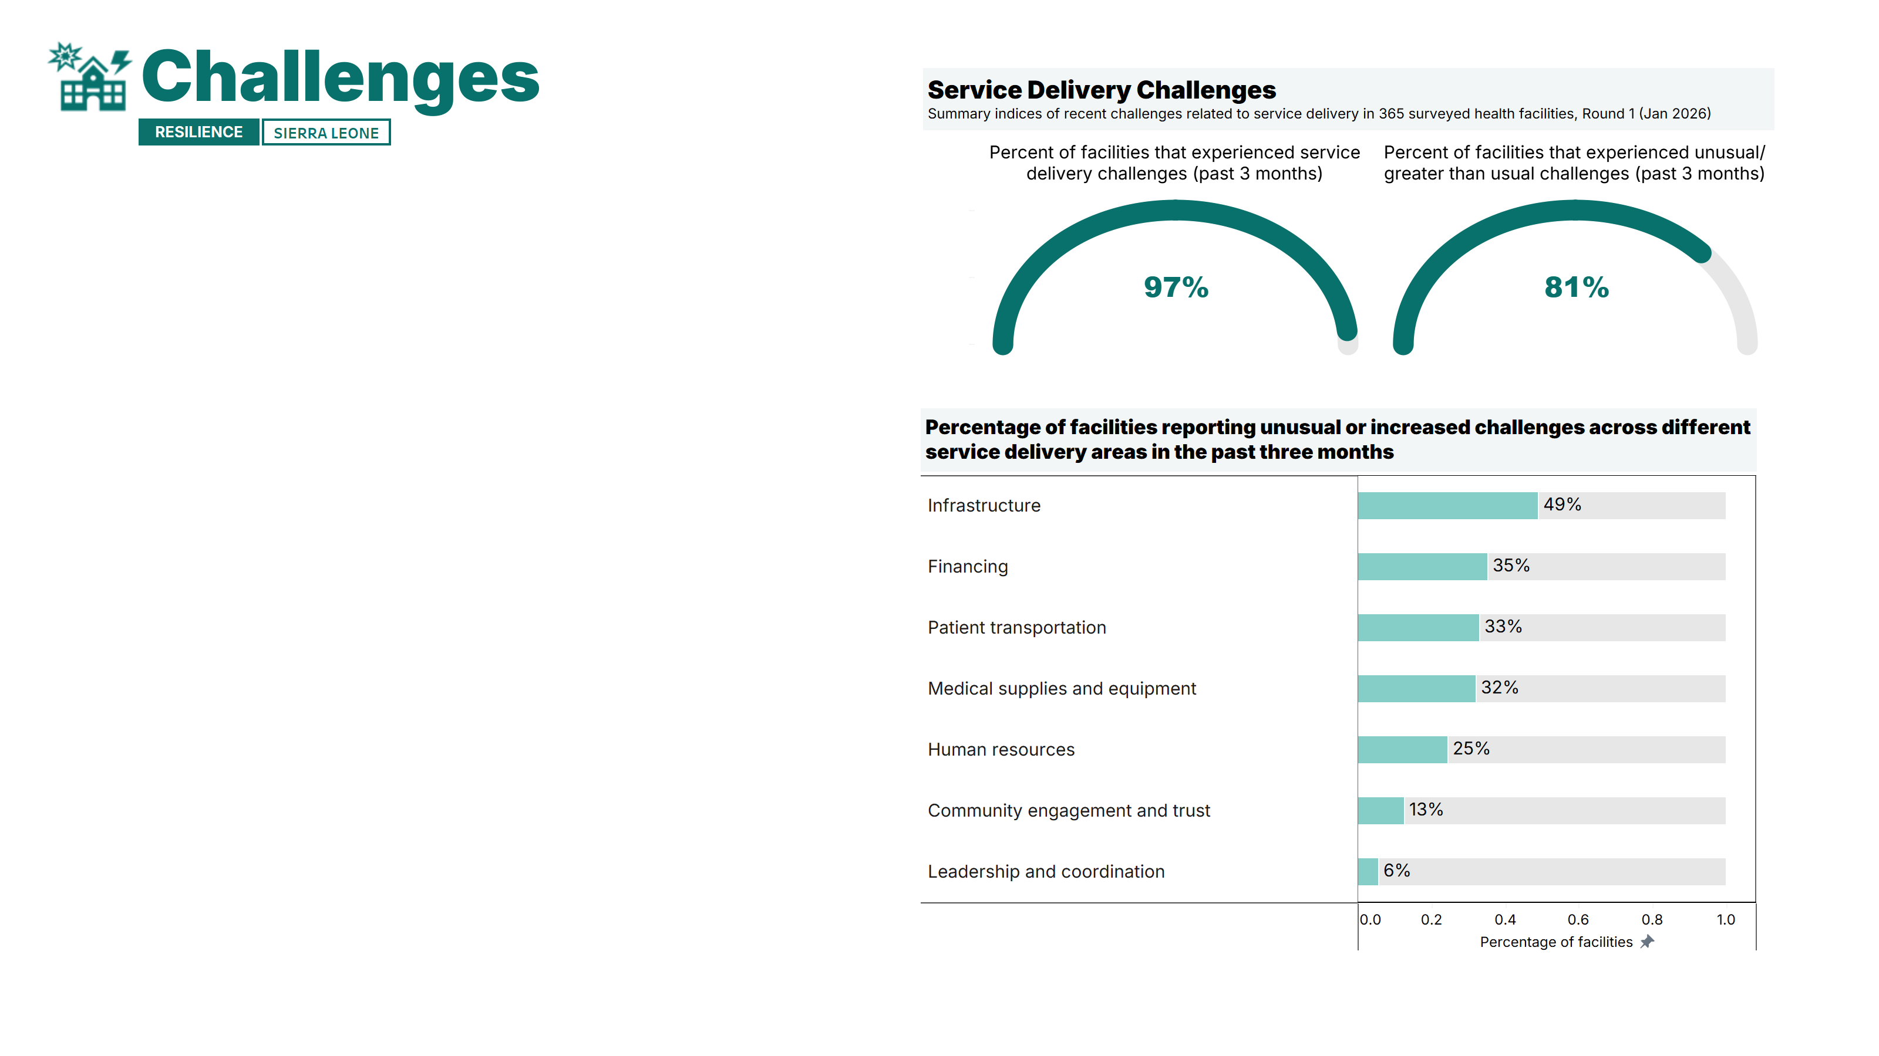
81% of health facilities reported unusual or increased challenges with service delivery in the three months preceding the survey.
The most frequently reported challenges relate to infrastructure (reported by about half of facilities), as well as financing and patient transportation.
Facility managers emphasized transport constraints, weak infrastructure (lack of electricity, water, and adequate buildings), and staff shortages as major barriers, disrupting service delivery and limiting outreach, referrals, and productivity. These issues, combined with financial constraints and insufficient medical supplies (forcing patients to buy drugs externally), reduce service availability and quality while also discouraging patients from accessing care.
*The two composite indices are calculated based on the list of service delivery challenges the graph above. Note: A detailed breakdown of results by facility type, area, and region is available in the annex of the report. DH: District hospital; CHC: Community Health Center; CHP: Community Health Post; MCHP: Maternal and Child Healthcare Post.
Notes:
First to challenges…we firstly asked whether the facility had experienced service delivery challenges in the past 3 months. As we can see here, 97% of facilities indicated that they had experienced a challenge. [read slide]

Slide 10
Health facilities reported providing on average 82% of key services, but only 4% offered the full package of all essential services.
Basic maternal, newborn, and child health services were reported as widely available. Child nutrition services were more limited, particularly the treatment of children with moderate (MAM) or severe acute malnutrition (SAM).
Mental health services, basic surgical care, and cervical cancer screening were rarely offered – with fewer than one-third of facilities reporting availability of these services.
Availability of basic RMNCAH-N services was higher overall in district hospitals and lower in MCHP facilities.
*The two composite indices are calculated based on the list of health services presented in the graph above. Note: A detailed breakdown of results by facility type, area, and region is available in the annex of the report. DH: District hospital; CHC: Community Health Center; CHP: Community Health Post; MCHP: Maternal and Child Healthcare Post.
Notes:
The next domain was services. [read slide]

Slide 11
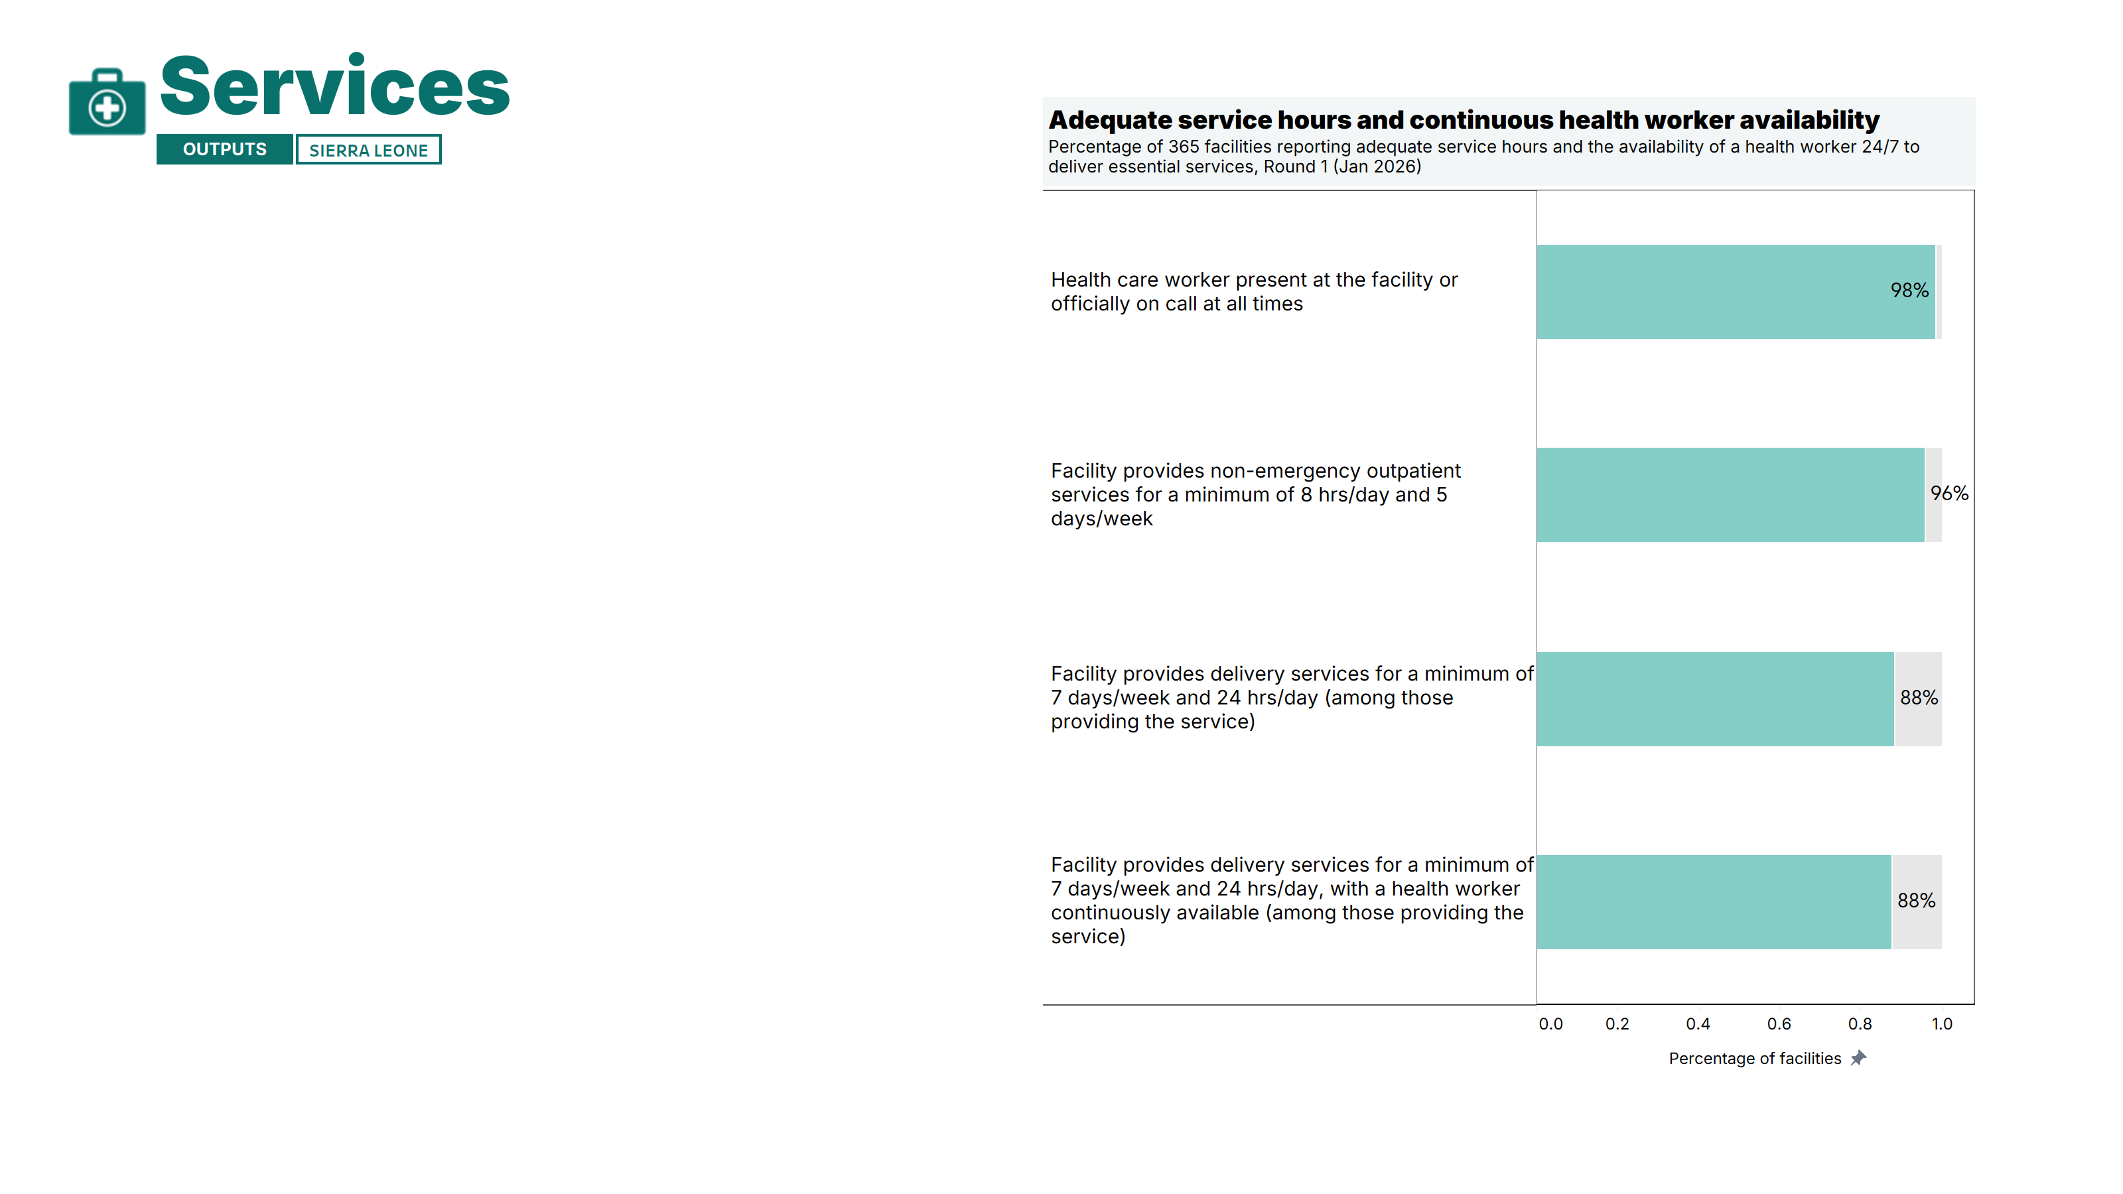
Nearly all health facilities reported providing non-emergency outpatient services for at least 8 hours per day, 5 days a week.
Among facilities offering delivery services, a large majority (88%) reported being open 24/7 with a healthcare worker continuously available, reflecting strong availability of critical services.
Note: A detailed breakdown of results by facility type, area, and region is available in the annex of the report. DH: District hospital; CHC: Community Health Center; CHP: Community Health Post; MCHP: Maternal and Child Healthcare Post.
Notes:
Next, we asked about service hours and continuous health worker availability. [read slide]

Slide 12
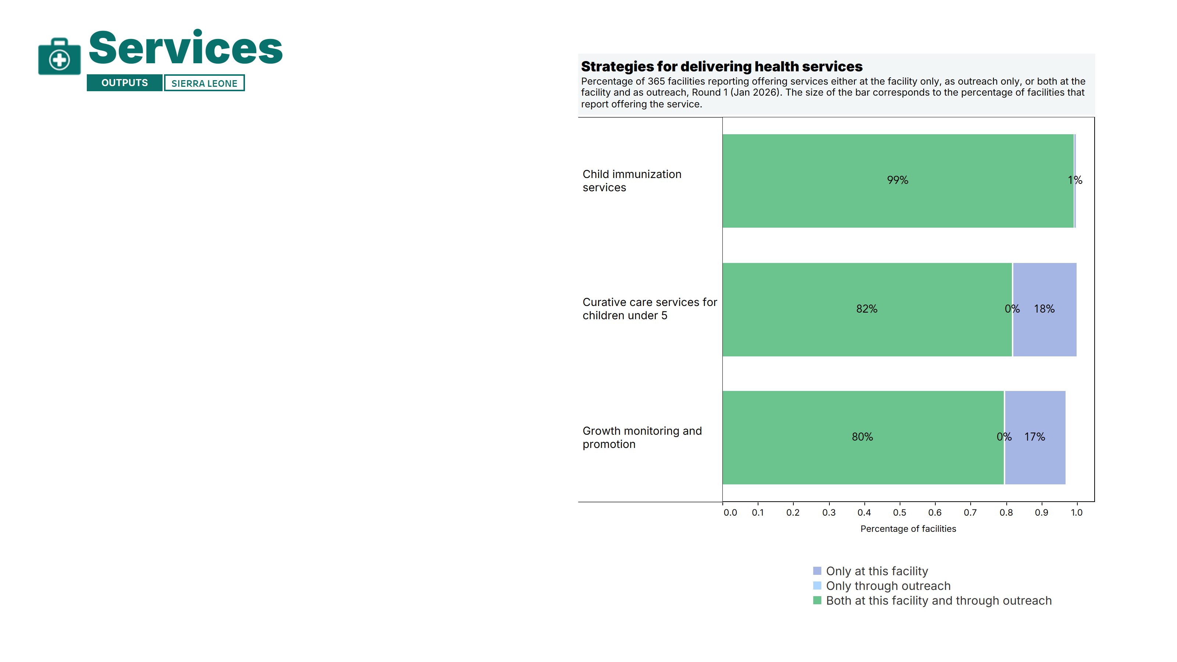
Outreach services were generally widely available across surveyed facilities.
Nearly all facilities reported offering child immunization through both fixed and outreach strategies.
A large majority (>80%) also provided outreach growth monitoring, promotion, and curative care services for children.
Notes:
And then lastly in the service domain, we asked how certain services were provided to clients. [read slide]

Slide 13
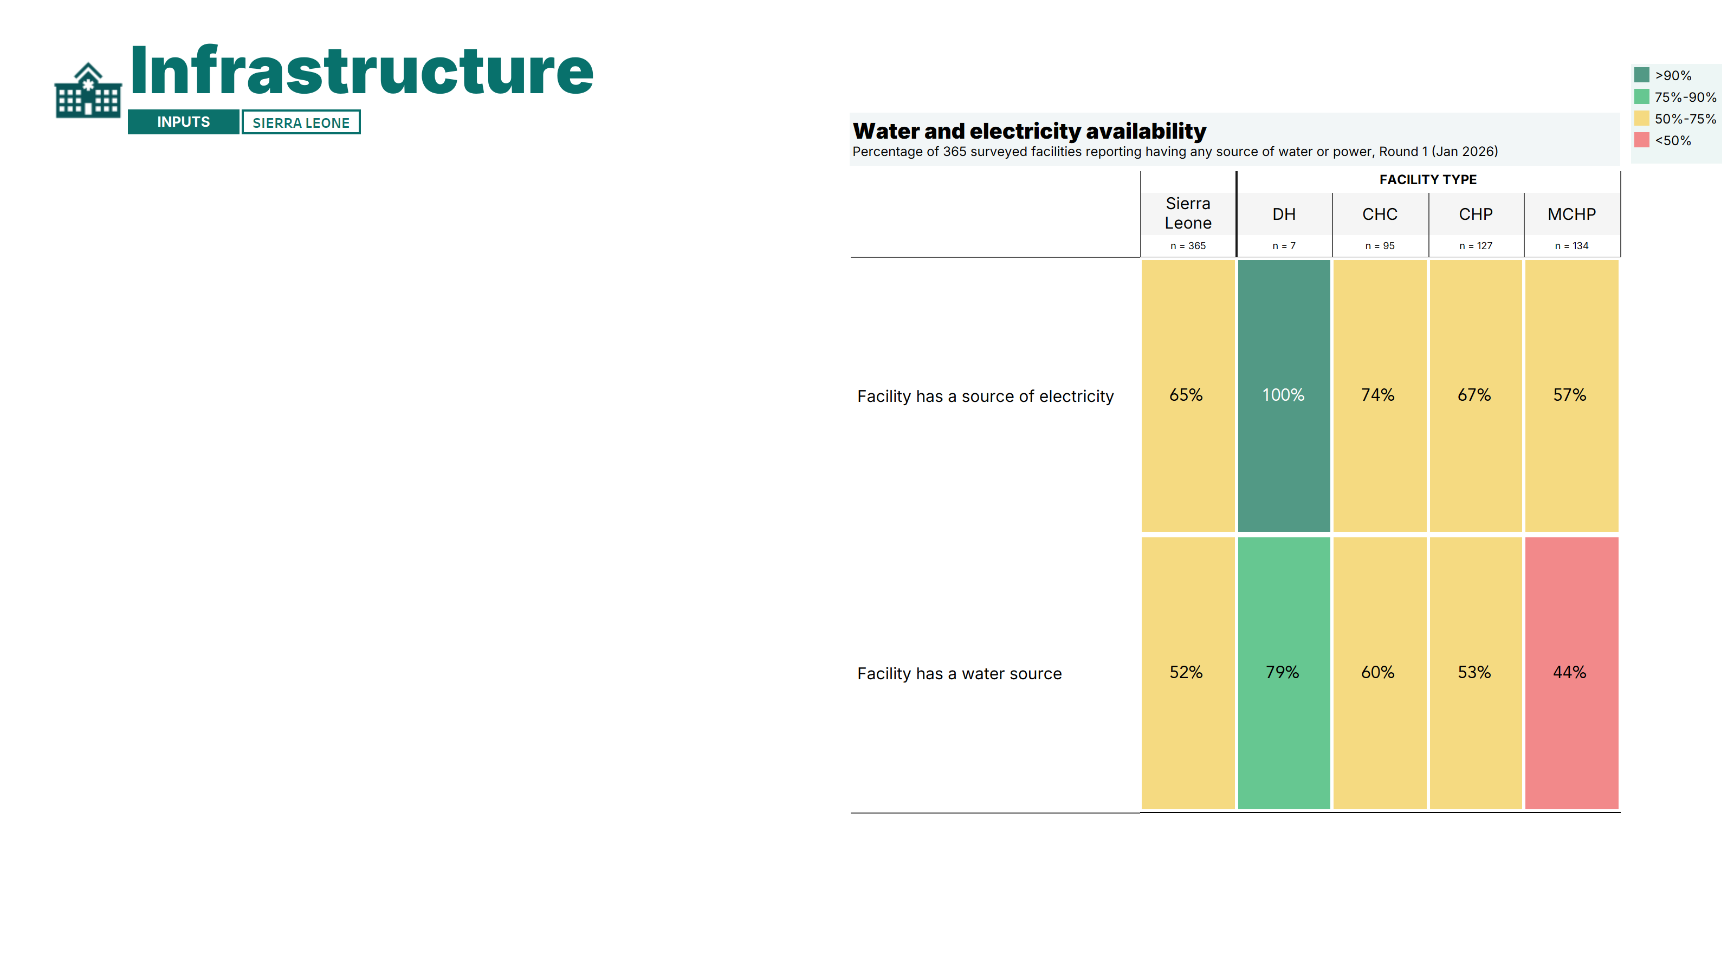
Major gaps in the availability of water and power were reported in facilities.
Only 65% of health facilities reported having at least one source of electricity, and only half had a water source.
District hospitals had relatively higher availability of these basic utilities – despite 21% reporting having no water source.
Lower-level facility types reported worse availability of power and electricity overall, with the MCHP facilities showing the poorest availability.
[Additional infrastructure findings will become available in subsequent survey rounds]
Note: A detailed breakdown of results by facility type, area, and region is available in the annex of the report. DH: District hospital; CHC: Community Health Center; CHP: Community Health Post; MCHP: Maternal and Child Healthcare Post.
Notes:
The next domain was infrastructure. We start by looking at whether facilities reported having an electricity or water source. [read slide]

Slide 14
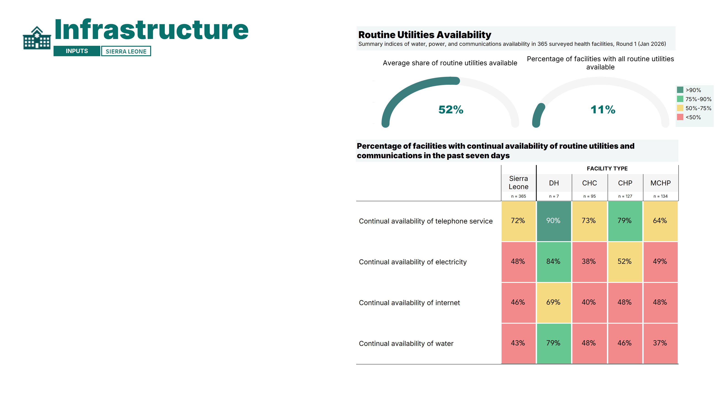
Only 52% of health facilities reported having all routine utilities (telephone, internet, water, and electricity) available without interruption over the past seven days.
While telephone service was continuously available in 72% of facilities, fewer than half reported uninterrupted internet, water, or electricity.
Continual availability of routine utilities was higher overall in district hospitals and lower in MCHP facilities.
[Additional infrastructure findings will become available in subsequent survey rounds]
*The two composite indices are calculated based on the list of routine utilities presented in the graph above. Note: A detailed breakdown of results by facility type, area, and region is available in the annex of the report. DH: District Hospital; CHC: Community Health Center; CHP: Community Health Post; MCHP: Maternal and Child Healthcare Post.
Notes:
On this slide, we look at the summary of all the different infrastructure items that were asked about for this round, which include telephone survey, electricity, internet and water. For this particular question, facilities are asked if they did not have access to these items in the past 7 days. [read slide]

Slide 15
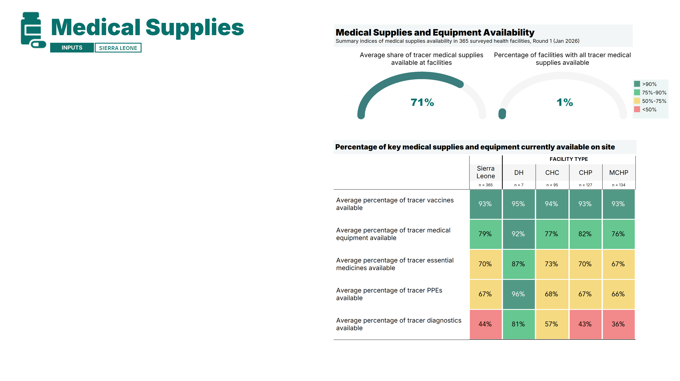
Health facilities reported having, on average, 71% of the survey’s tracer medical supplies and equipment, yet almost none had the complete set of essential items.
Vaccine and equipment availability was generally high across all facility types, while the availability of tracer medicines and PPE was moderate.
Significant gaps were noted in the availability of tracer diagnostics in CHC, CHP, and MCHP facilities.
District hospitals reported high availability of all tracer medical supplies.
*The two composite indices are calculated based on the full list of tracer medical supplies resented in the subsequent slides, excluding contraceptive commodities (see Methodology Annex for a full description of the methodology). Note: A detailed breakdown of results by facility type, area, and region is available in the annex of the report. DH: District hospital; CHC: Community Health Center; CHP: Community Health Post; MCHP: Maternal and Child Healthcare Post.
Notes:
The last module that was asked about was medical supplies. In this section, we asked about vaccines, medicines, PPE, equipment and diagnostics. This slide shows the average percent of each supply or equipment type that was available at the national level, as well as at each facility type. [read slide]

Slide 16
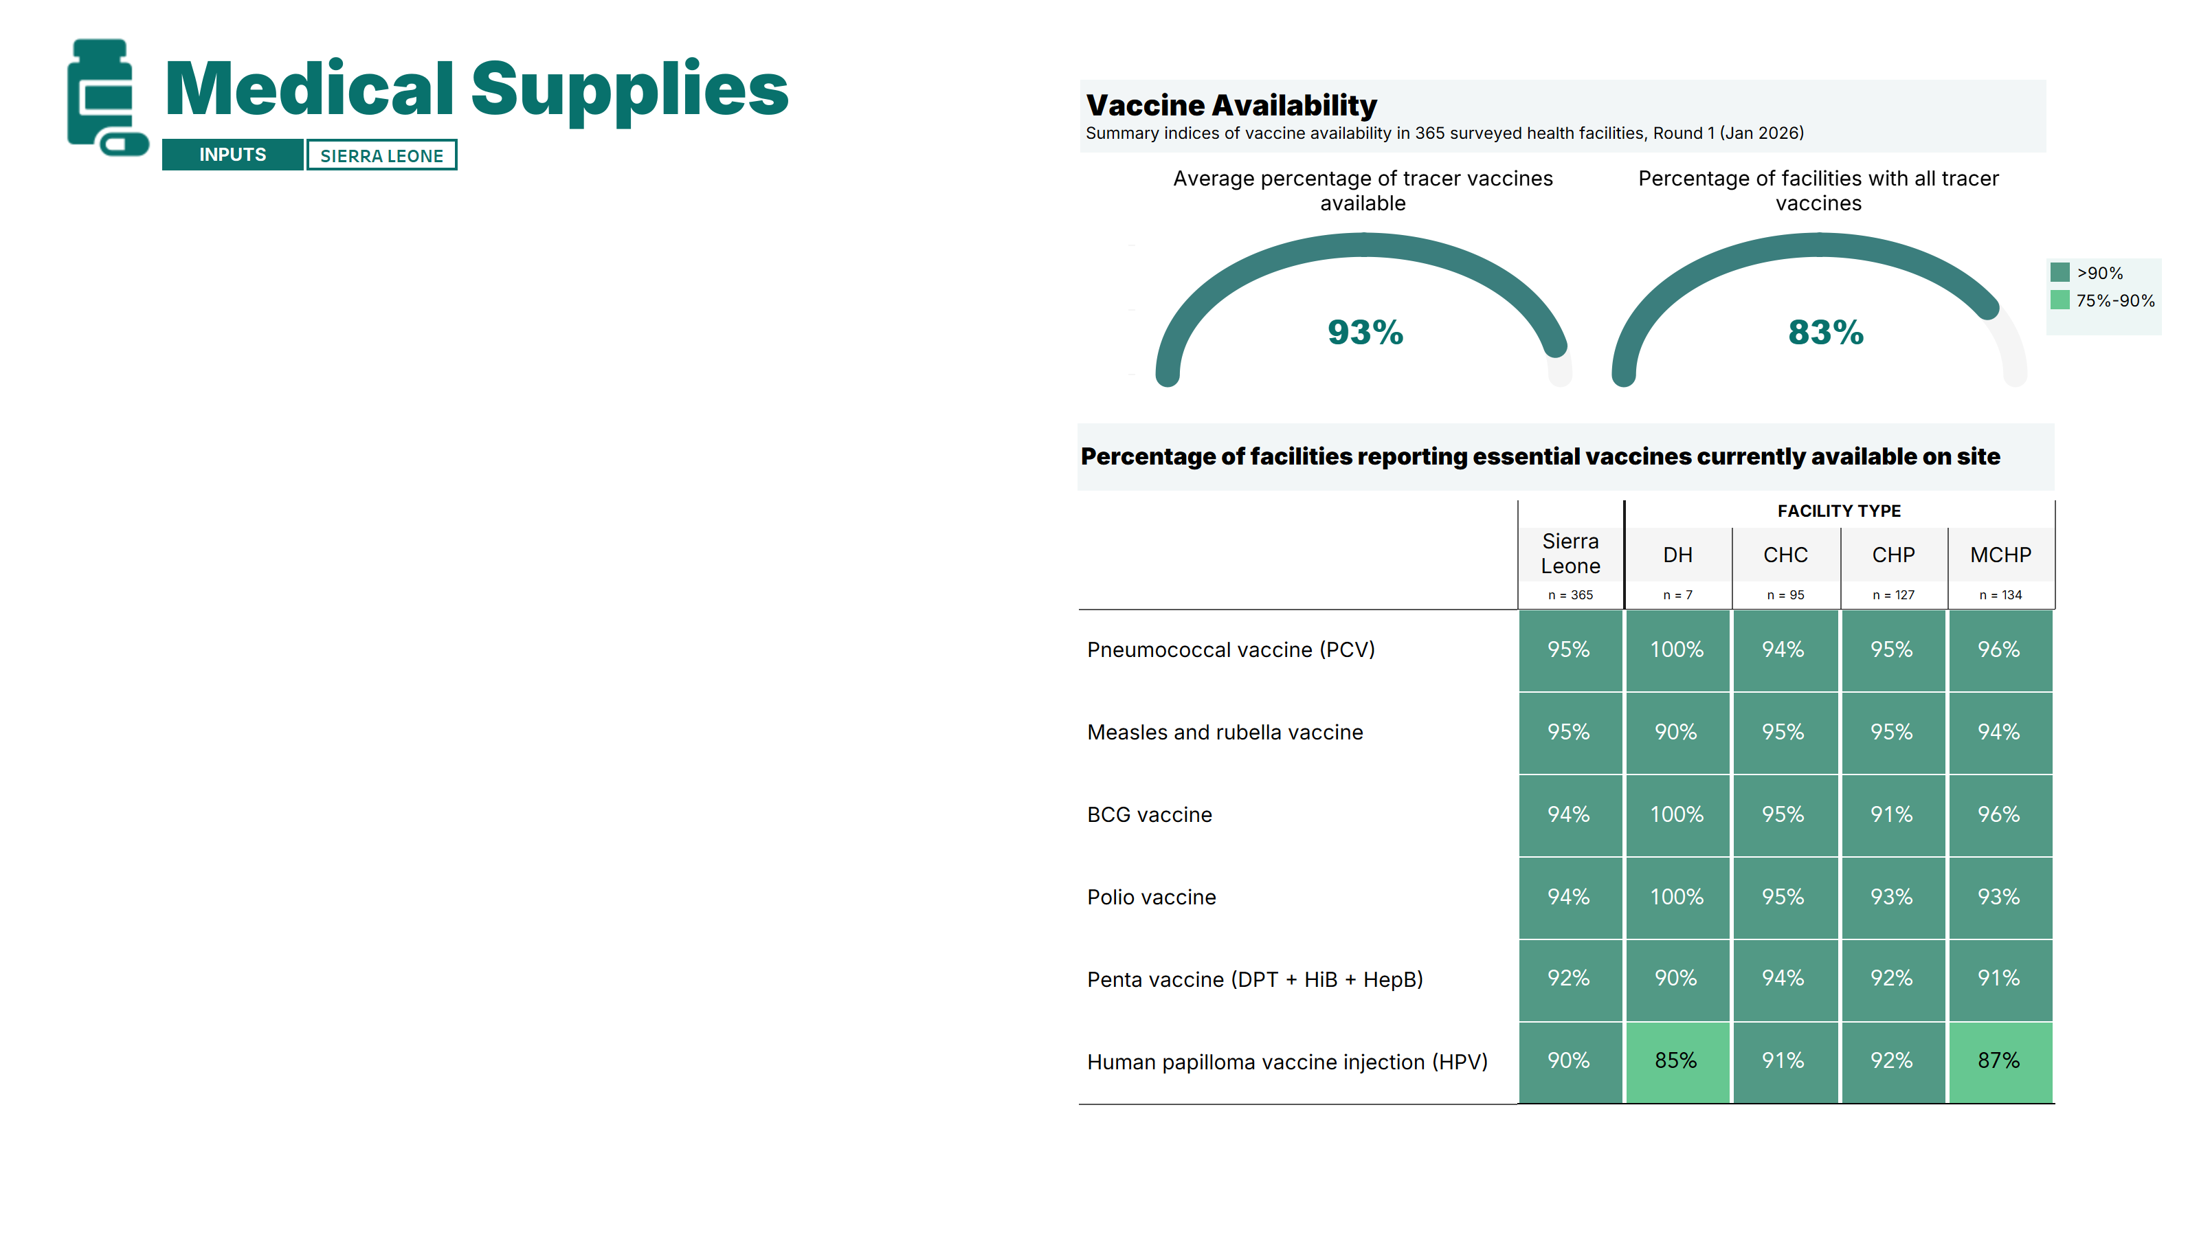
Facilities generally had essential vaccines in stock, with 83% of facilities reporting that all tracer vaccines were available on site.
Availability of tracer vaccines was high across all facility types.
*The two composite indices are calculated based on the list of vaccines presented in the graph above. Note: A detailed breakdown of results by facility type, area, and region is available in the annex of the report. DH: District hospital; CHC: Community Health Center; CHP: Community Health Post; MCHP: Maternal and Child Healthcare Post.
Notes:
We now have individual slides for each of the supplies/equipment. This slide focuses on vaccine availability. [read slide]

Slide 17
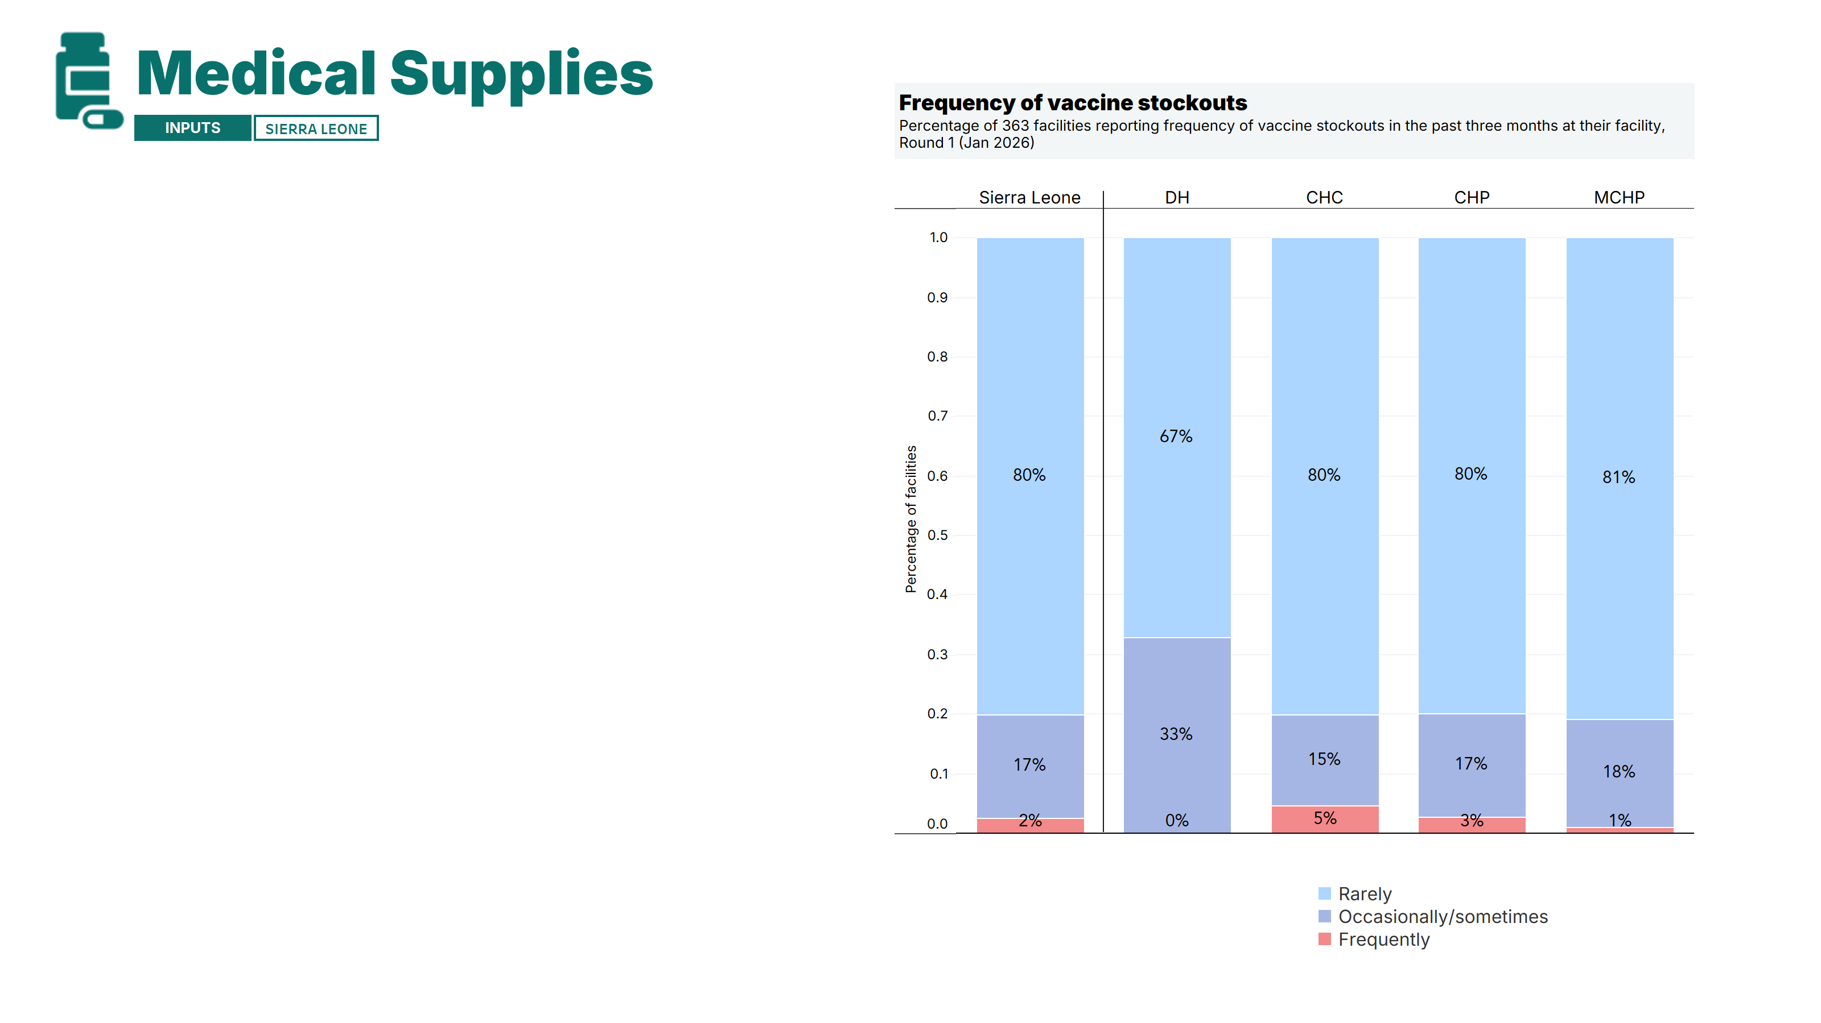
When asked about vaccine stockouts over the past three months, most facilities (80%) reported that stockouts were rare, while 17% reported occasional stockouts.
The occurrence of occasional stockouts was relatively similar across facility types, albeit somewhat more frequent in district hospitals.

Slide 18
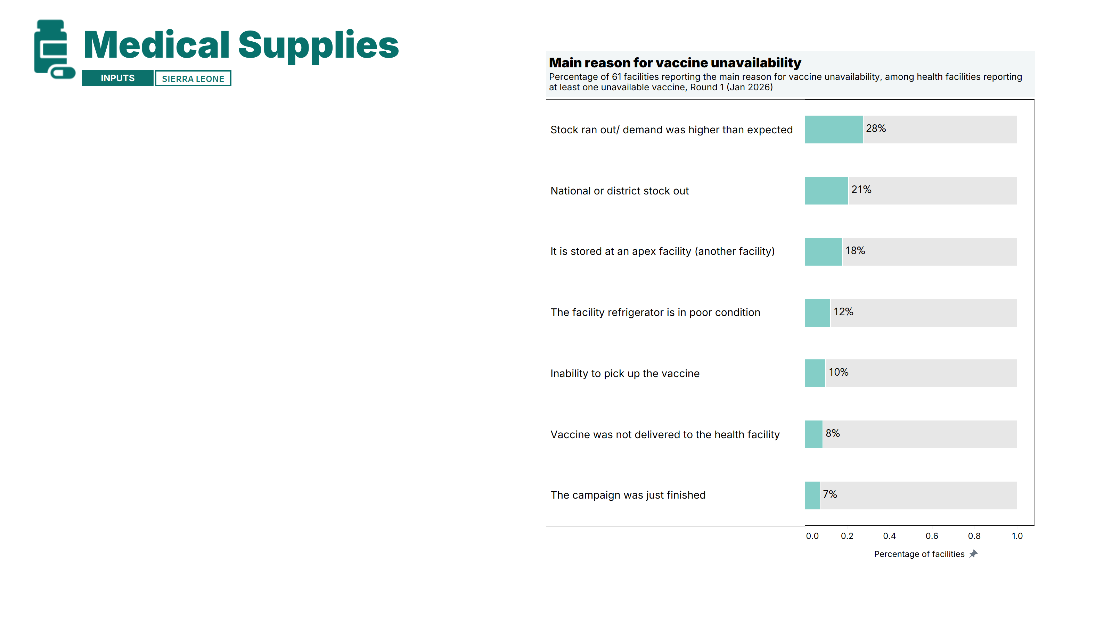
Among the 61 facilities reporting missing at least one of the six tracer vaccines, the most cited reason was stocks running out or demand exceeding expectations (28%) – potentially pointing to challenges with planning and supply chain management.
Note: A detailed breakdown of results by facility type, area, and region is available in the annex of the report. DH: District hospital; CHC: Community Health Center; CHP: Community Health Post; MCHP: Maternal and Child Healthcare Post.
Notes:
This slide looks at the main reason for vaccine unavailability. [read slide]

Slide 19
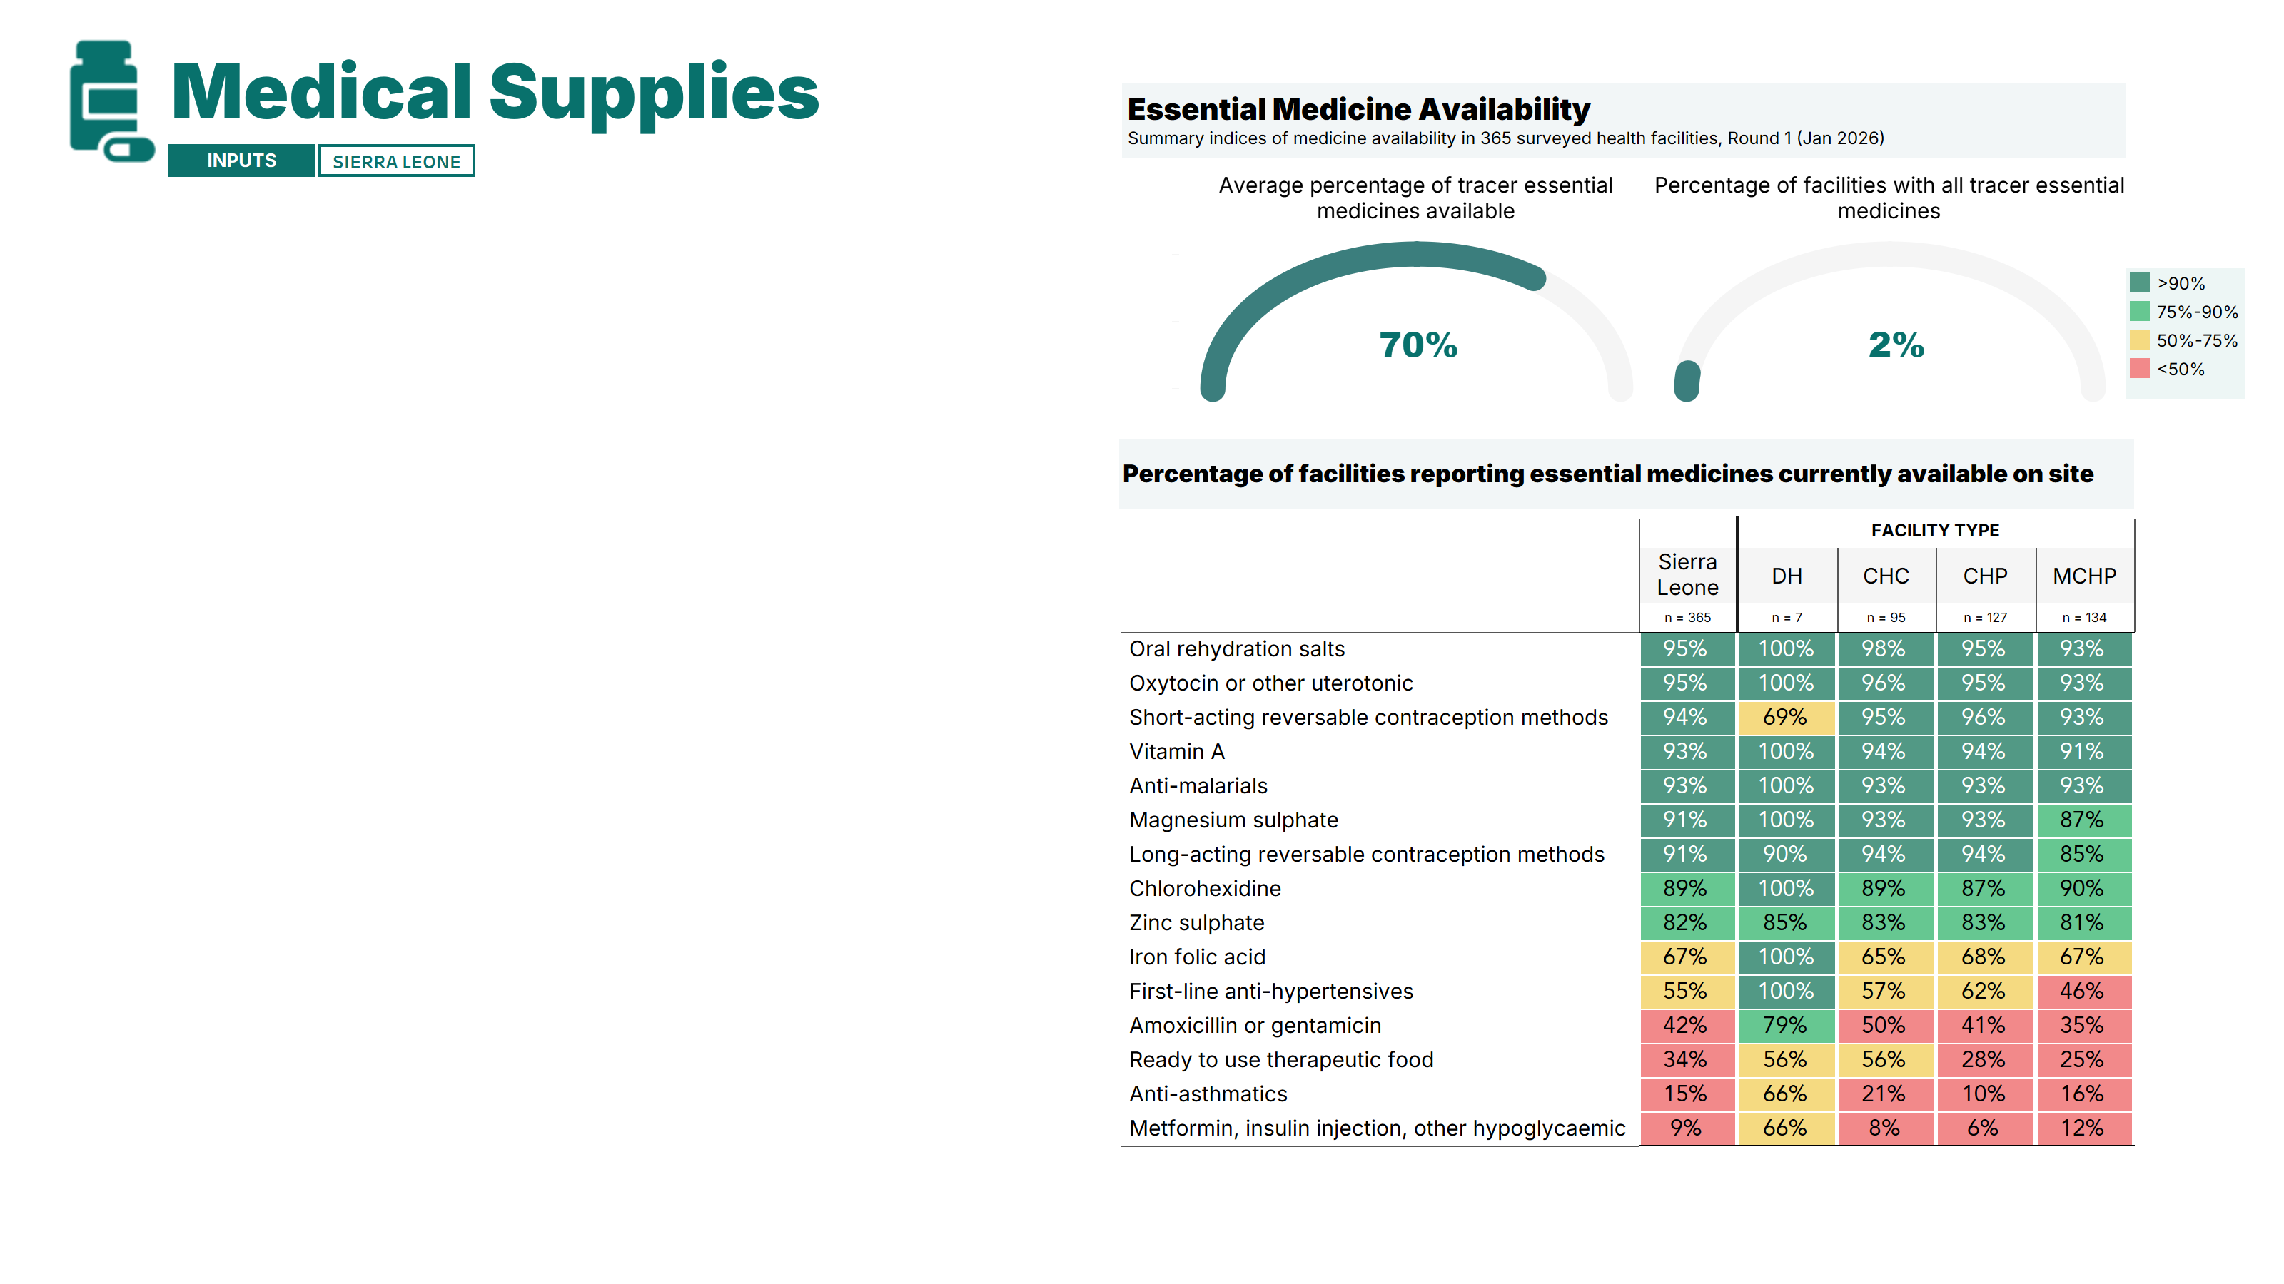
Health facilities reported having, on average, 70% of the survey’s tracer essential medicines on site, yet only 2% of facilities had the full set of tracer medicines.
RMNCAH-N medicines were generally well stocked – with contraceptive methods, ORS, oxytocin, magnesium sulfate and vitamin A reported available in over 90% of facilities. Zinc sulphate and iron–folic acid were moderately available.
On the other hand, ready-to-use therapeutic food was available in only 34% of facilities, and NCD-related commodities were low overall, despite 85% of facilities reporting that they offer NCD services.
Antibiotic availability was particularly concerning, with less than half of facilities reporting having amoxicillin or gentamicin on site.
*The two composite indices are calculated based on the list of tracer essential medicines presented in the graph above. Note: A detailed breakdown of results by facility type, area, and region is available in the annex of the report. DH: District hospital; CHC: Community Health Center; CHP: Community Health Post; MCHP: Maternal and Child Healthcare Post.
Notes:
Next, are the medicines. [read slide]

Slide 20
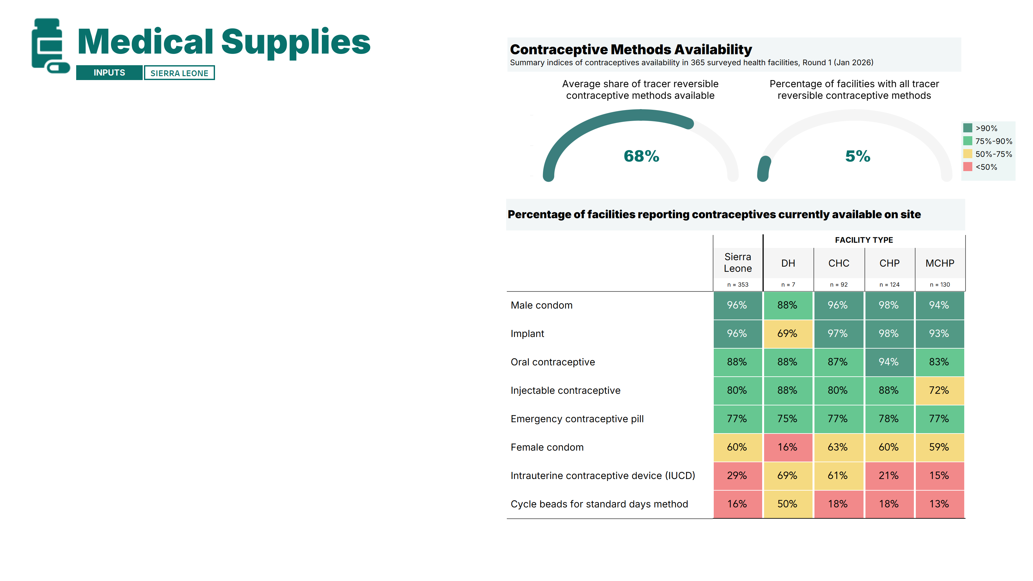
Health facilities reported having, on average, 68% of the survey’s tracer contraceptive methods available on site.
Although most common contraceptive methods were widely available, uterine intrauterine devices (IUCDs, 29%) and cycle beads for the Standard Days Method (16%) were very limited.
Notably, 23% of facilities reported not having emergency contraceptive pills available.
*The two composite indices are calculated based on the list of tracer contraceptives presented in the graph above. Note: A detailed breakdown of results by facility type, area, and region is available in the annex of the report. DH: District hospital; CHC: Community Health Center; CHP: Community Health Post; MCHP: Maternal and Child Healthcare Post.
Notes:
The next slide looks at the availability of contraceptive methods. [read slide]

Slide 21
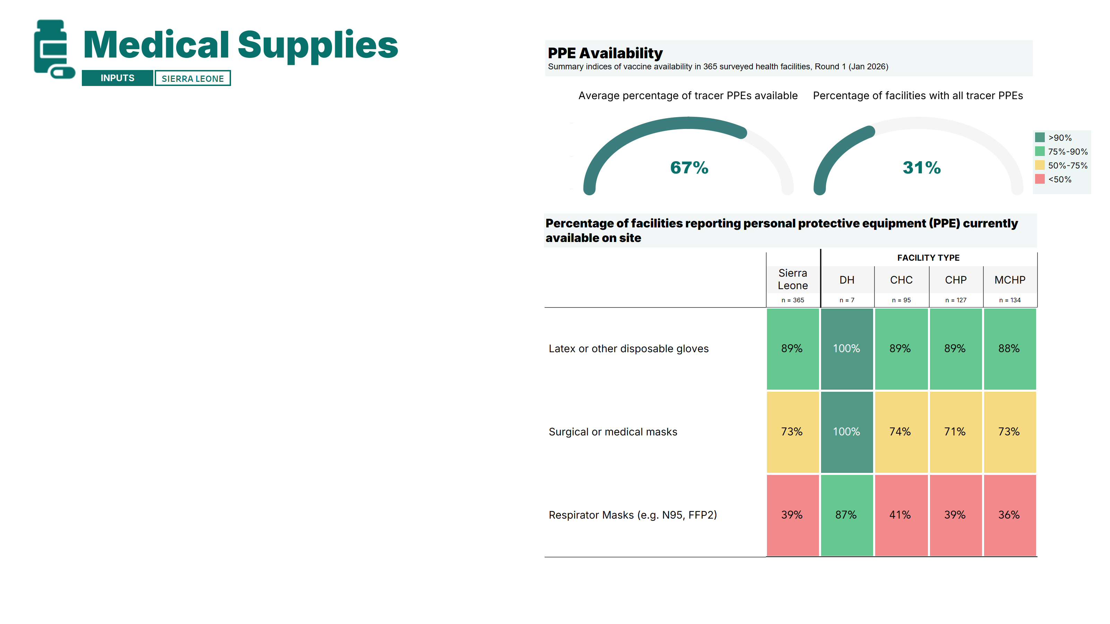
Health facilities reported having, on average, 67% of the survey’s tracer essential personal protective equipment (PPE) on site.
Most facilities had disposable latex gloves, while surgical/medical masks were moderately available.
Respirator masks (e.g., N95 or FFP2) were particularly scarce, available in only 39% of facilities.
District hospitals reported higher availability of basic PPE than other facility types.
*The two composite indices are calculated based on the list of PPE presented in the graph above. Note: A detailed breakdown of results by facility type, area, and region is available in the annex of the report. DH: District hospital; CHC: Community Health Center; CHP: Community Health Post; MCHP: Maternal and Child Healthcare Post.
Notes:
Next, we look at PPE availability. [read slide]

Slide 22
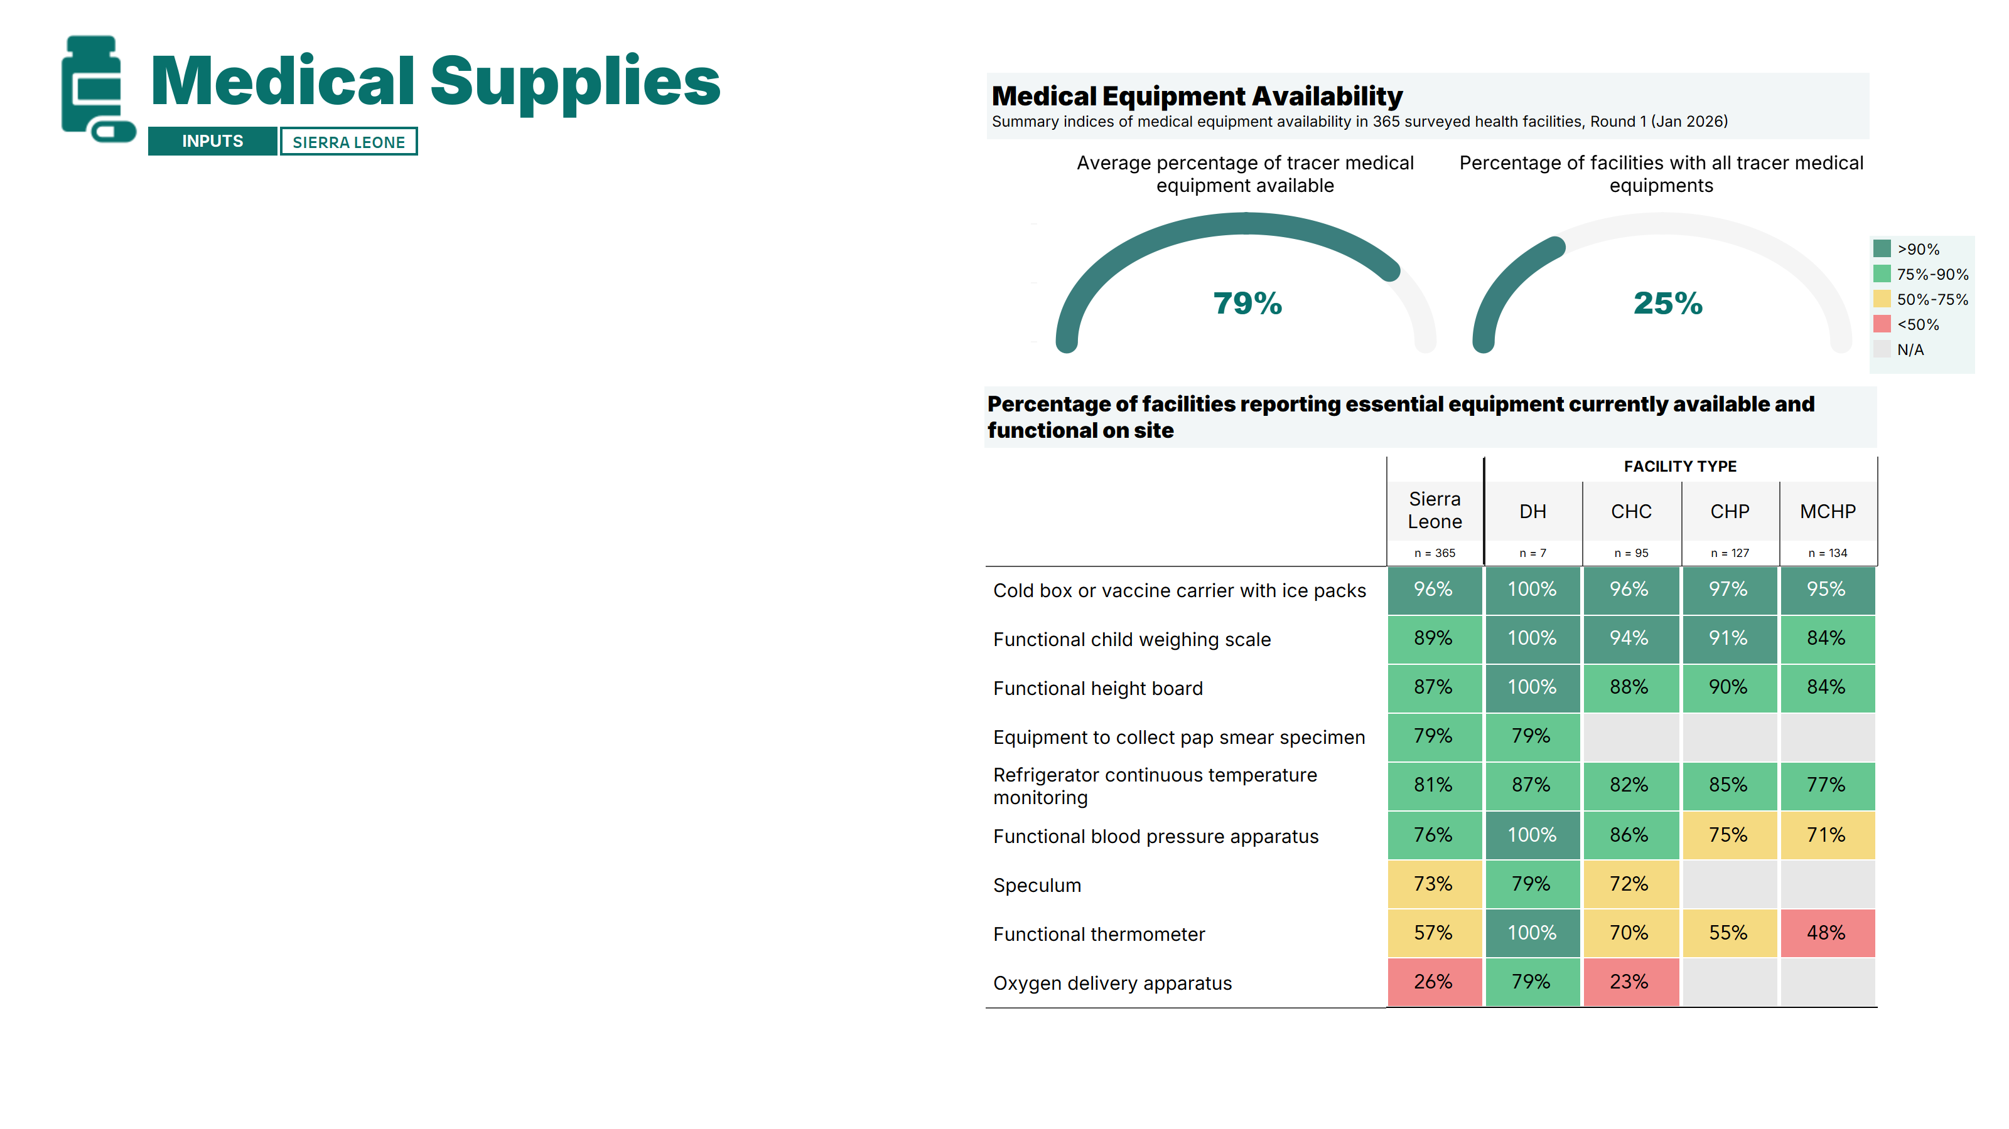
Health facilities reported having, on average, 79% of tracer medical equipment available and functional.
Functional immunization and growth monitoring equipment was widely available, with most facilities reporting child weighing scales, height boards, and cold boxes or vaccine refrigerators; however, 20% reported refrigerator temperature excursions outside the 2–8°C range [See Annex].
In contrast, reproductive and maternal health equipment was limited: only 72% of CHCs had functional speculums and 23% had oxygen delivery apparatuses—highlighting gaps in obstetric emergency care. Notably, only 57% of facilities had a functional thermometer.
District hospitals reported higher availability of basic equipment, with larger gaps in MCHP facilities.
*The two composite indices are calculated based on the list of medical equipment presented in the graph above. Note: A detailed breakdown of results by facility type, area, and region is available in the annex of the report. DH: District hospital; CHC: Community Health Center; CHP: Community Health Post; MCHP: Maternal and Child Healthcare Post.
Notes:
Next, is equipment availability. [read slide]

Slide 23
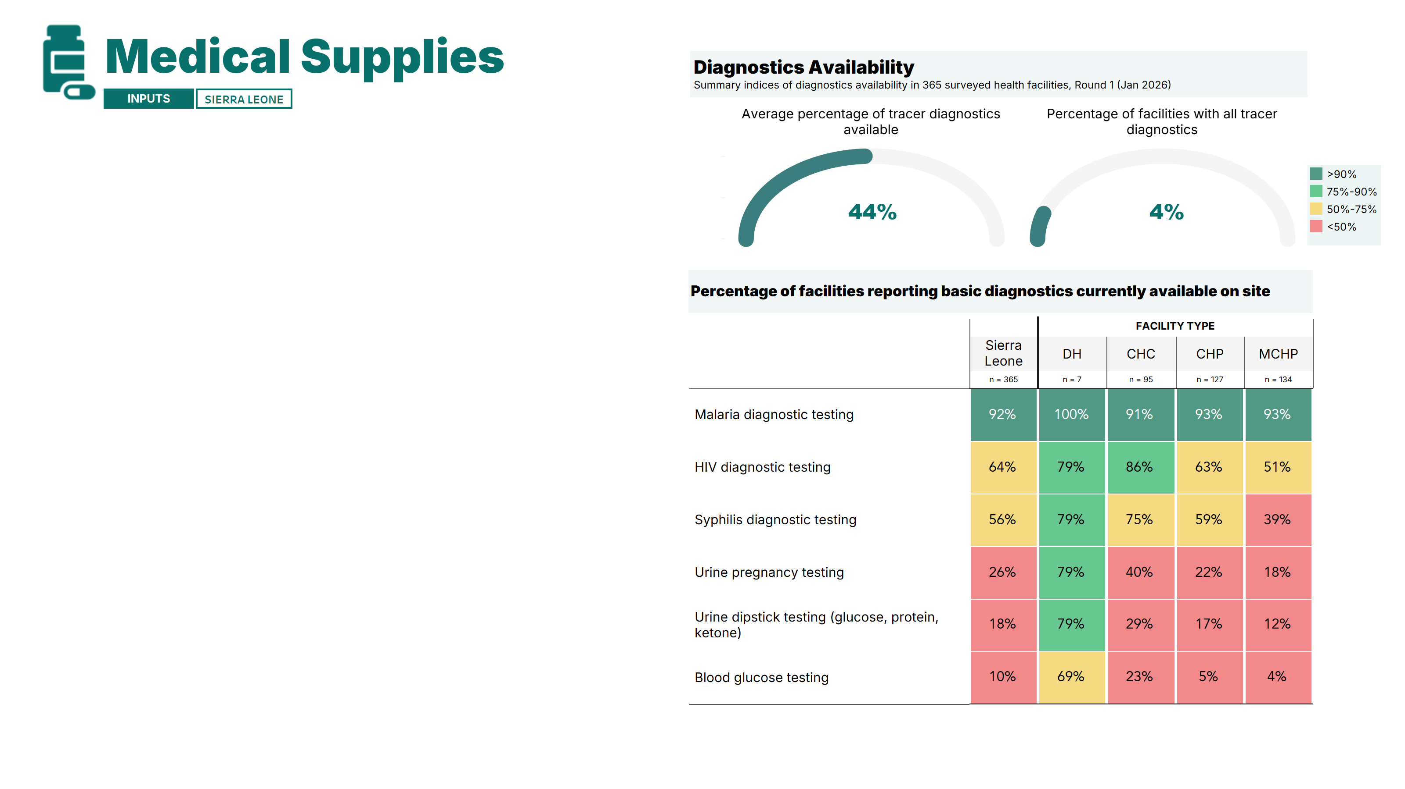
Health facilities reported having, on average, only 44% of the survey’s tracer diagnostics on site.
Availability of communicable disease diagnostics was relatively higher: malaria rapid diagnostic tests were widely available, while HIV and syphilis tests were only moderately available.
In contrast, basic maternal and newborn health diagnostics were very limited, despite near-universal service provision: only 26% of facilities had urine pregnancy tests, 18% had urine dipsticks (used for pre-eclampsia screening), and 10% had blood glucose testing available.
*The two composite indices are calculated based on the list of tracer diagnostics presented in the graph above. Note: A detailed breakdown of results by facility type, area, and region is available in the annex of the report. DH: District hospital; CHC: Community Health Center; CHP: Community Health Post; MCHP: Maternal and Child Healthcare Post.
Notes:
Last, we have the diagnostics. [read slide]

Slide 24
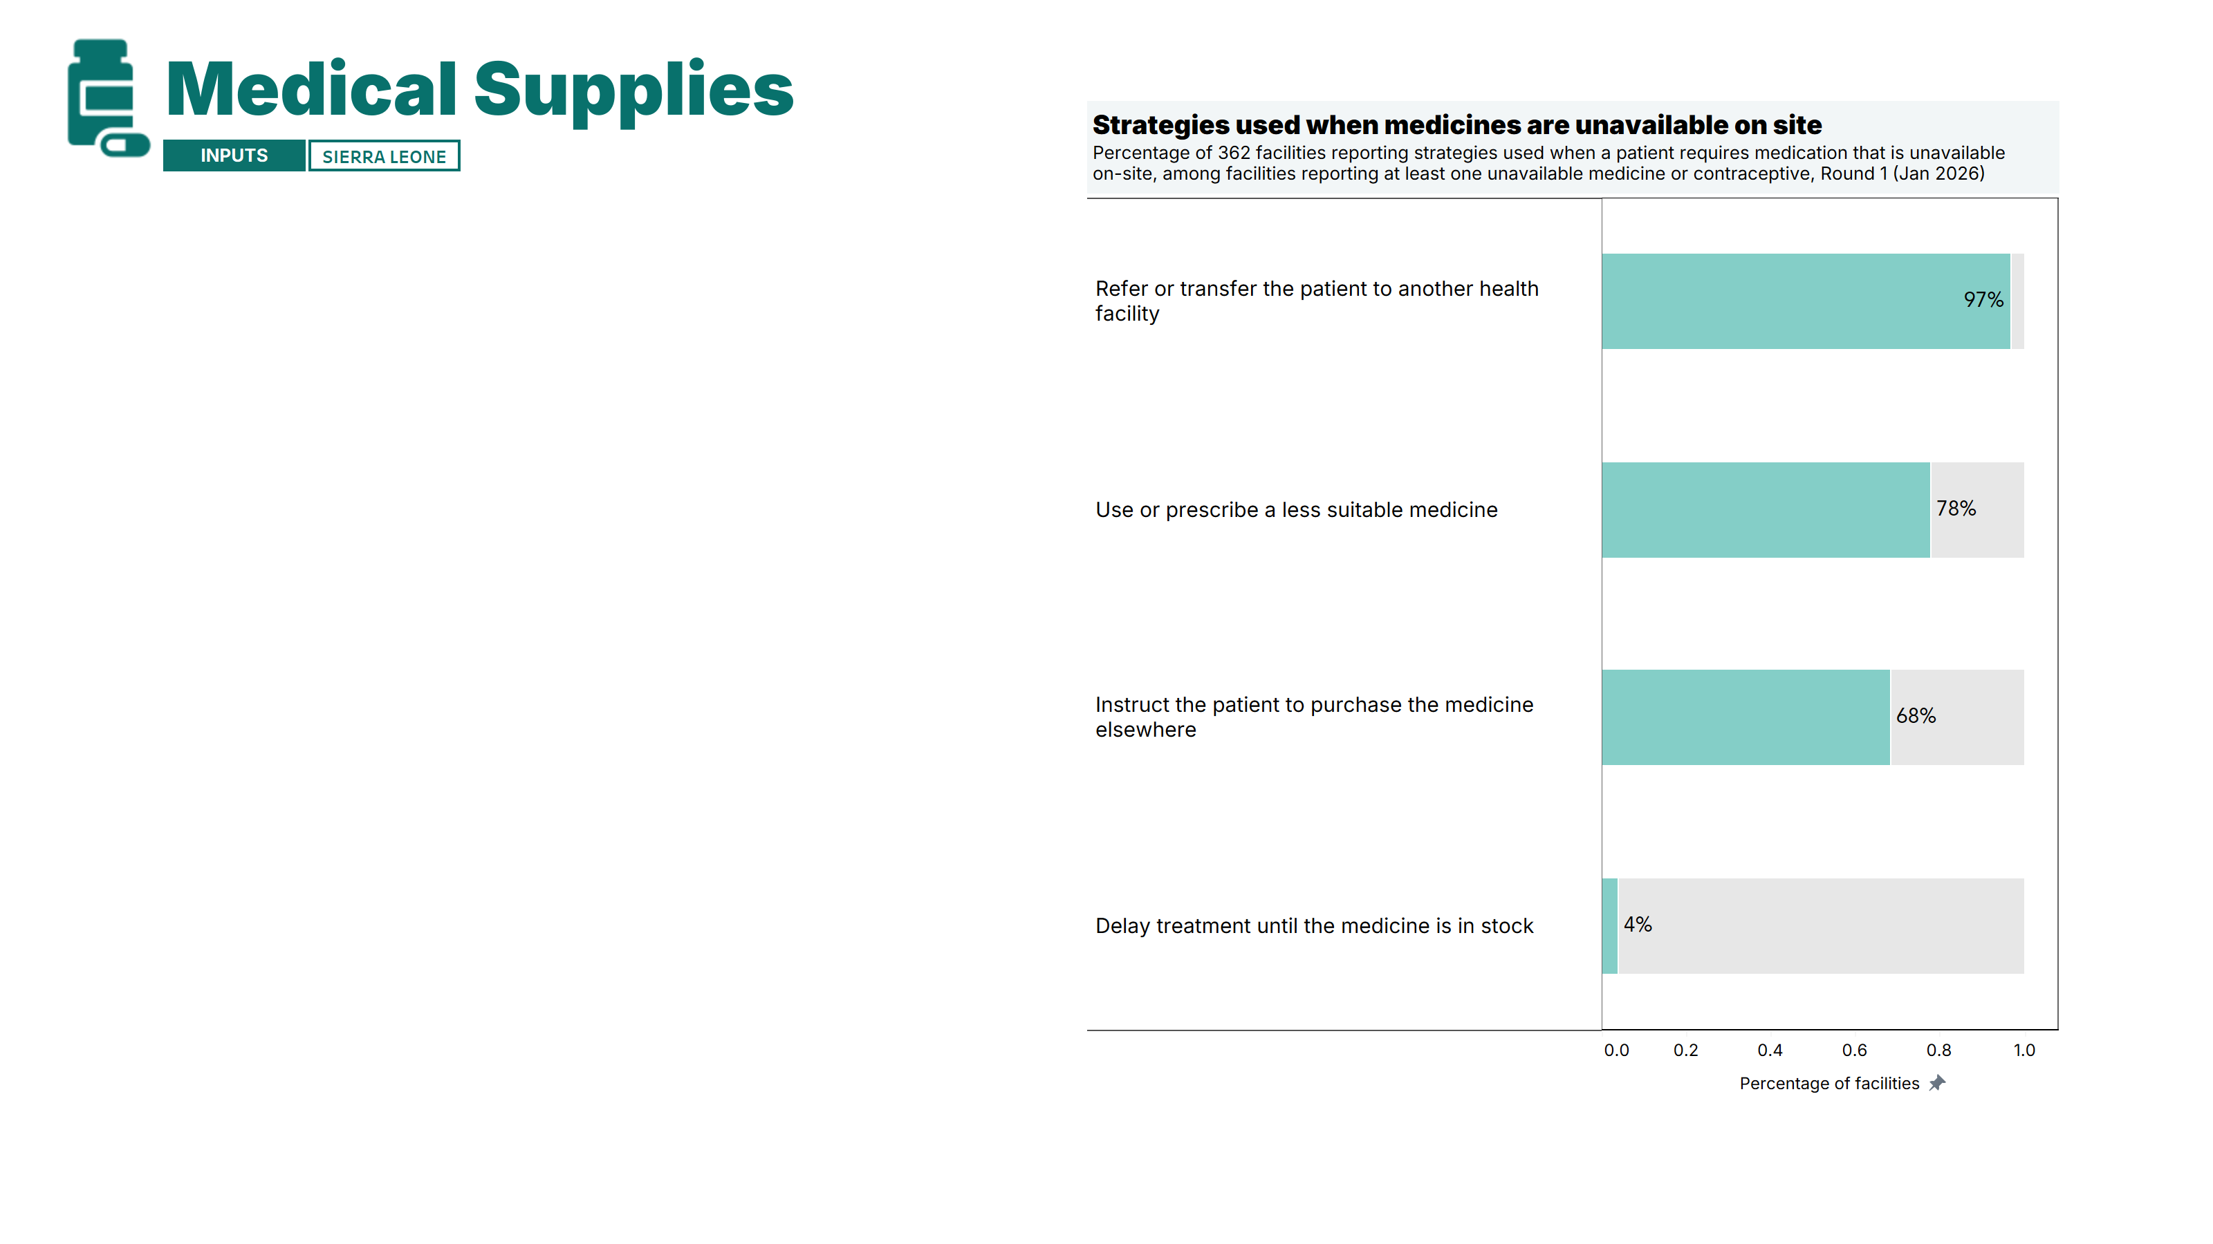
Most facilities reported referring patients to another health facility or asking them to purchase medicines elsewhere when items were unavailable.
However, a substantial proportion of facilities (78%) reported prescribing a less appropriate medicine – an alternative drug that is not the recommended first-line treatment* –in such situations.
This indicates that stock shortages often force facilities to compromise on treatment quality.
Note: A detailed breakdown of results by facility type, area, and region is available in the annex of the report. DH: District hospital; CHC: Community Health Center; CHP: Community Health Post; MCHP: Maternal and Child Healthcare Post. *A ‘Less suitable medicine’ refers to an alternative drug that is not the recommended first-line treatment because the required medicine is out of stock. It is typically a second-choice option that may be less effective, have more side effects, or not fully align with clinical guidelines.
Notes:
In the supplies section, facilities were asked a follow-up question if they reported a medicine was not available at the facility when a patient required it. [read slide]

Slide 25
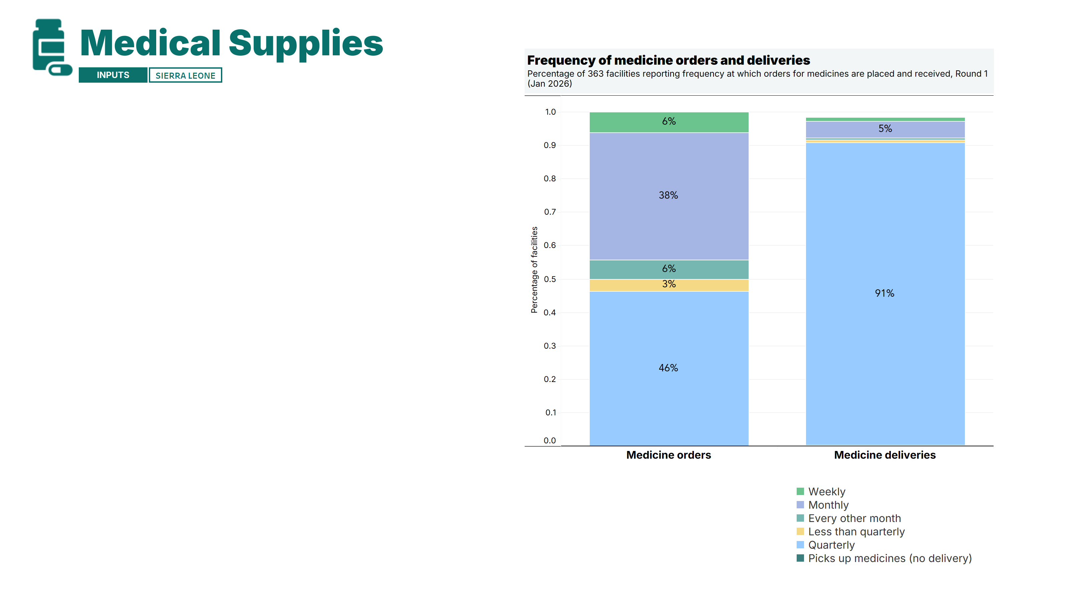
Most facilities reported placing medicine orders on a monthly or quarterly basis, though the large majority received these orders quarterly.
Responsibility for calculating medicine orders varied across facilities: most (69%) relied on the Officer in Charge (OIC), with pharmacists (5%) and nursing staff (7%) also mentioned.
Notes:
The next questions look at medicine ordering and record keeping. This slide looks at how frequently medicines are ordered and delivered. [read slide]

Slide 26
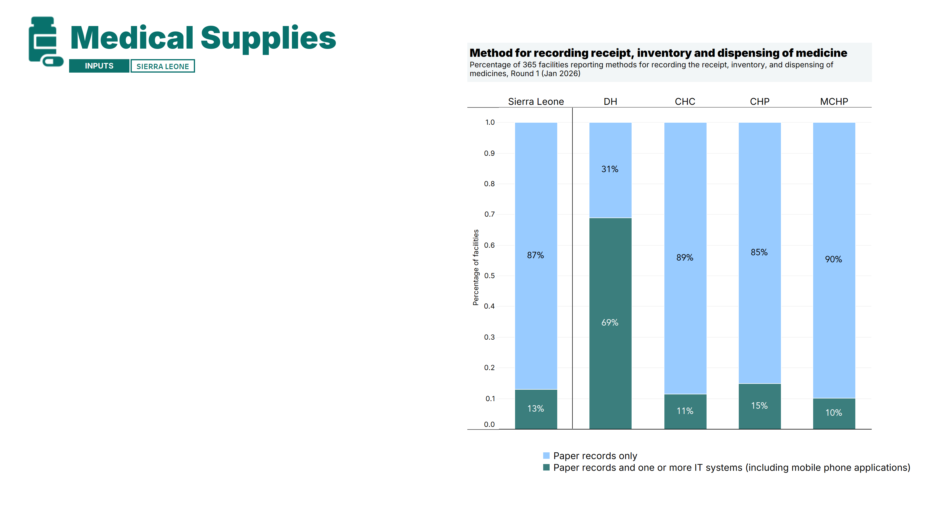
Use of IT systems was very limited. Most health facilities (87%) reported using paper records only to document the receipt, inventory, and dispensing of medicines. 13% used a combination of IT and paper records, while none relied solely on IT systems.
However, district hospitals diverged from this pattern, with a majority (69%) reporting using a mix of paper records and IT systems.
Among the 48 facilities using both IT and paper, the majority (90%) reported that IT systems were fully functional over the past seven days [See Annex].
Note: A detailed breakdown of results by facility type, area, and region is available in the annex of the report. DH: District hospital; CHC: Community Health Center; CHP: Community Health Post; MCHP: Maternal and Child Healthcare Post.
Notes:
This slide shows the breakdown for recording receipt, inventory and the dispensing of medicines at the facility. [read slide]

Slide 27
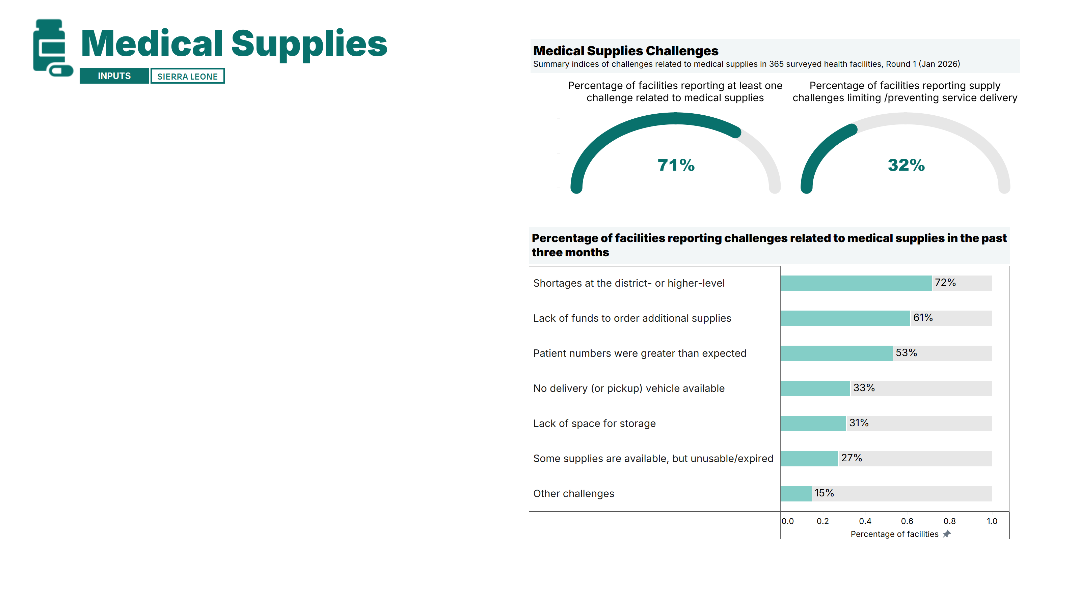
Facilities reported several challenges in maintaining adequate medical supplies: 71% of facilities experienced at least one challenge, with 32% facing issues that limited or prevented service delivery.
Common problems included shortages at the district or higher level, insufficient funds to place orders, and unexpected patient surges. Additionally, among 281 facilities supplying CHWs, 21% were unable to fulfill at least one request over the past three months [See Annex].
Facility managers noted that supply shortages often lead to patient referrals to other facilities or, in some cases, prevent care from being delivered altogether.
Note: A detailed breakdown of results by facility type, area, and region is available in the annex of the report. DH: District hospital; CHC: Community Health Center; CHP: Community Health Post; MCHP: Maternal and Child Healthcare Post.
Notes:
And lastly, facilities were asked whether medical supplies were a challenge at the facility. [read slide]

Slide 28
Summary of Findings
The first round of the survey highlighted important service readiness gaps in PHC facilities in Sierra Leone. A large majority of facilities reported recent unusual or increased service delivery challenges, most commonly related to infrastructure, financing, and patient transport. These challenges are reflected in major deficits in basic utilities: only 65% of facilities reported having access to at least one source of electricity and 52% reported having a water source.
Overall service availability was relatively high. Basic maternal, newborn, and child health services were widely available, including near-universal provision of ANC, PNC, newborn care, immunization, IMCI, IYCF, and delivery services – with most delivery facilities reporting operating 24/7. However, gaps remain in nutrition and reproductive services: only about two-thirds of facilities treated children with SAM or MAM, just 15% of CHCs offered cervical cancer screening, and 42% of CHCs provided basic surgical services.
Availability of medical supplies and equipment was moderate: vaccines and basic equipment were generally well stocked, while tracer medicines, PPE, and especially diagnostics—particularly in CHCs, CHPs, and MCHPs—showed significant gaps. Although most facilities reported offering basic maternal and newborn care, the availability of essential tests during ANC was limited: only 18% had urine dipstick tests for glucose, protein, or ketones (critical for screening preeclampsia and gestational diabetes), 26% had pregnancy tests, and only 10% conducted blood glucose testing. Key maternal and newborn health commodities were also insufficient: iron–folic acid was available in only two-thirds of facilities, first-line antihypertensives in 55%, and functional thermometers in 57%. Antibiotic availability was particularly concerning, with less than half of facilities having amoxicillin or gentamicin – pointing to important gaps in facilities’ readiness to provide basic maternal services.
Gaps were also noted in contraceptive availability, despite all facilities reporting provision of family planning services. Male condoms and implants were widely available, but only 77% of facilities stocked emergency contraceptive pills, 60% female condoms, and 29% IUCDs, pointing to potential improvements in the comprehensiveness of FP care.
Performance varied by facility type: district hospitals were generally better equipped and prepared, while lower-level facilities, particularly MCHPs, faced more pronounced challenges.
Plus de détails sur la méthodologie sont disponibles sur GitHub (https://fastr-analytics.github.io/fastr-resource-hub/).

Slide 29
Strengths and limitations of phone surveys
Growing academic literature and GFF’s experience implementing phone surveys indicates the potential for rapid-cycle phone survey approaches to complement, but not replace, traditional, in-person surveys. Results should be interpreted as signals and with considerations to limitations of phone-based approaches.
Strengths
Potential under-representation of facilities in areas with low phone connectivity
Shorter surveys are employed to mitigate respondent fatigue
Simplified language usage may be necessary
Limitations exist in measuring the quality of services provided solely through phone surveys
In-ability of in-person verification; all results are self-reported by the respondent
Enables a cost-effective, continuous data collection platform
Helpful for monitoring in rapidly changing contexts and to capture changes over time
Flexibility in scheduling interviews may lead to higher participation rates
Potential for reduced social desirability bias with sensitive topics which may enhance data accuracy
Phone surveys allows for easier monitoring of data collection quality and enumerator behavior (e.g., calls can be recorded, with consent, for quality checks and training purposes)
Limitations
For more information on the FASTR initiative: https://data.gffportal.org/key-theme/FASTR

Slide 30
3. Annex
Notes:
Quel est l’objectif de FASTR ? L’idée de FASTR est que les analyses à cycle rapide peuvent accélérer les améliorations en matière de santé et de nutrition reproductive, maternelle, néonatale, infantile et des adolescents en favorisant une utilisation systématique des données pour la prise de décision. Actuellement, de nombreux pays dépendent d’enquêtes à grande échelle, réalisées en présentiel, très coûteuses, et qui ne sont menées que tous les 4 à 5 ans — voire moins fréquemment. Bien que ces enquêtes restent importantes, l’objectif de FASTR est de les compléter par une collecte de données plus rapide et régulière. En générant des informations en temps utile entre les grandes enquêtes, nous pouvons mieux suivre les progrès, identifier les défis et ajuster les programmes et politiques de manière plus agile et réactive.

Slide 31
Contents
Overview
Primary Health Care (PHC) Assessment
Service Delivery Challenges
Service Availability
Infrastructure
Medical Supplies
Annex
Methodology Annex
Annex Tables
Background on the FASTR initiative
@ UNICEF Sierra Leone/2016/Mason

Slide 32
SURVEY SAMPLE | DISTRIBUTION AND MARGINS OF ERROR Sierra Leone Rapid HFA, Round 1 (Jan 2026)
 |  | Number of facilities in sample (N) | Percentage of sample (%) | Number of facilities in sampling frame (N) | Margin of error (p.p.)
NATIONAL | Sierra Leone | 365 | 100.0% | 1458 | 3.7%
FACILITY TYPE | DH | 7 | 1.9% | 15 | 23.6%
 | CHP | 127 | 34.8% | 499 | 6.3%
 | CHC | 95 | 26.0% | 314 | 7.1%
 | MCHP | 134 | 36.7% | 630 | 6.3%
ZONE | Urban | 66 | 18.1% | - | -
 | Rural | 299 | 81.9% | - | -
REGION | Eastern | 78 | 21.4% | 330 | 8.2%
 | North-West | 74 | 20.3% | 234 | 8.0%
 | Northern | 84 | 23.0% | 315 | 7.7%
 | Southern | 87 | 23.8% | 458 | 8.0%
 | Western-Area | 42 | 11.5% | 121 | 10.3%
DISTRICT | Bo | 25 | 6.8% | 151 | 15.1%
 | Bombali | 22 | 6.0% | 83 | 15.2%
 | Bonthe | 17 | 4.7% | 92 | 18.2%
 | Falaba | 12 | 3.3% | 50 | 21.0%
 | Kailahun | 20 | 5.5% | 89 | 16.3%
 | Kambia | 25 | 6.8% | 70 | 13.3%
 | Karene | 22 | 6.0% | 61 | 14.2%
 | Kenema | 30 | 8.2% | 135 | 13.3%
 | Koinadugu | 17 | 4.7% | 70 | 17.5%
 | Kono | 28 | 7.7% | 106 | 13.4%
 | Moyamba | 21 | 5.8% | 110 | 16.3%
 | Port Loko | 27 | 7.4% | 103 | 13.7%
 | Pujehun | 24 | 6.6% | 105 | 14.9%
 | Tonkolili | 33 | 9.0% | 112 | 12.1%
 | Western Area Rural | 28 | 7.7% | 57 | 11.2%
 | Western Area Urban | 14 | 3.8% | 64 | 19.6%
Interpretation : There is a 90% chance that the real national value is within ± 3.7 percentage points of the measured/surveyed value. Margins of error were calculated assuming 90% confidence and 50% prevalence.
DH: District hospital; CHC: Community Health Center; CHP: Community Health Post; MCHP: Maternal and Child Healthcare Post.

Slide 33

Methodology | Survey tool and data analysis
Survey Tool
The cross-country base FASTR rapid-cycle health facility phone survey tool was adapted for Sierra Leone by the Ministry of Health, the Global Financing Facility/World Bank, and NOIPolls.
Standardized questions were included to enable comparisons with other large-scale surveys (e.g., HHFA, SARA, SDI, SPA).
Tailored Sierra Leone-specific questions addressed unique country priorities.
Two types of indicators are included: (1) annual indicators collected once and (2) quarterly indicators collected in all rounds.
Data analysis
The final report will present results as national estimates, disaggregated by facility type. Additional breakdowns by region will be provided in the annex.
Annual indicators are reported as weighted cross-sectional descriptive statistics using survey sampling weights to ensure representativeness.
Quarterly indicators will be presented separately for each survey round; statistical significance of differences between rounds has not been evaluated.
Summary scores are computed as the unweighted average of included indicators. Slides presenting summary scores also display individual indicator results below the index score.
For more information on the FASTR initiative: https://data.gffportal.org/key-theme/FASTR

Slide 34
Methodology | Sampling and weighting
Survey sampling and weighting
Sampling Frame: Primary health care (PHC) facilities in Sierra Leone were included (community health centers, community heath posts, hospitals, and maternal and child healthcare posts.
Stratified Sampling: Stratified by region and facility level to form a total of 19 strata. A sample of facilities were selected with equal probability from each stratum.
Sample Size: Targeted 330 facilities for the FASTR survey to ensure representativeness at national and regional levels and by facility type.

Slide 35
Index Scores | Medical Supplies
*Two summary scores for each domain
Average percentage of tracer supplies available at facilities
Percentage of facilities that have all tracer supplies
Thermometer
Child weighing scale
Height measuring board
Blood pressure apparatus
Oxygen delivery device
Speculum
Equipment to collect pap smear specimen (spatula, endocervical brushes)
Refrigerator with continuous temperature monitoring
Cold box / vaccine carrier with ice packs
EQUIPMENT SCORE*
Respirator masks (N95, FFP2)
Surgical or medical masks
Disposable latex gloves
PPE SCORE*
MEDICAL SUPPLIES SCORE*
Based on the full set of tracer medical supplies
Amoxicillin or gentamicin
Oral rehydration salts
Zinc sulphate
Oxytocin or other uterotonic
Magnesium sulphate
Iron folic acid
Chlorohexidine
Long-acting reversible contraception methods
Short-acting reversible contraception methods
Metformin, insulin injection, or another hypoglycemic agent
First-line anti-hypertensives
Anti-malarials
Ready-to-use therapeutic food
Vitamin A
MEDICINES SCORE*
VACCINES SCORE*
Measles and rubella vaccine
Penta (DPT + HiB + HepB) vaccine
BCG vaccine
Polio vaccine
PCV (pneumococcal vaccine)
Human papilloma vaccine (HPV) injection
Urine dipstick testing (glucose, protein, ketone)
Onsite blood glucose testing
Onsite malaria diagnostic testing
Onsite HIV diagnostic testing
Pregnancy test kit
Syphilis diagnostic testing (rapid test kit or specific assay kit – syphilis serology)
DIAGNOSTICS SCORE*

Slide 36
Contents
Overview
Primary Health Care (PHC) Assessment
Service Delivery Challenges
Service Availability
Infrastructure
Medical Supplies
Annex
Methodology Annex
Annex Tables
Background on the FASTR initiative
@ UNICEF Sierra Leone/2016/Mason

Slide 37
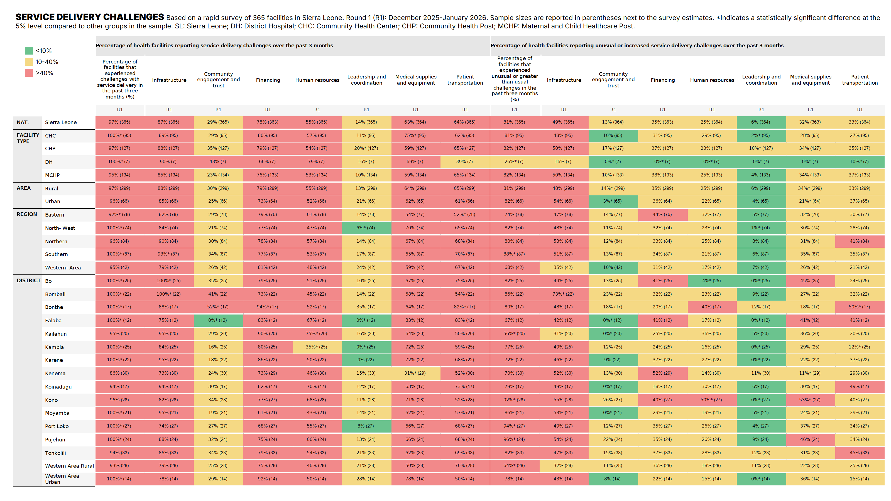

Slide 38
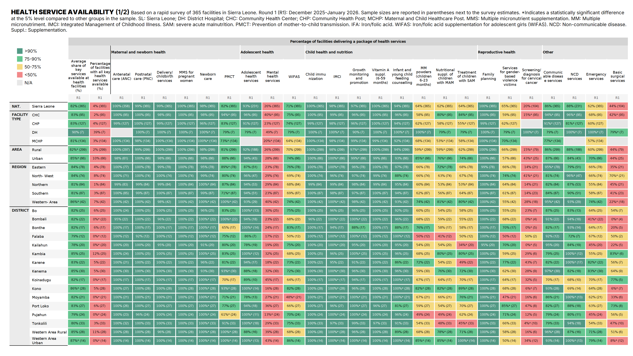

Slide 39
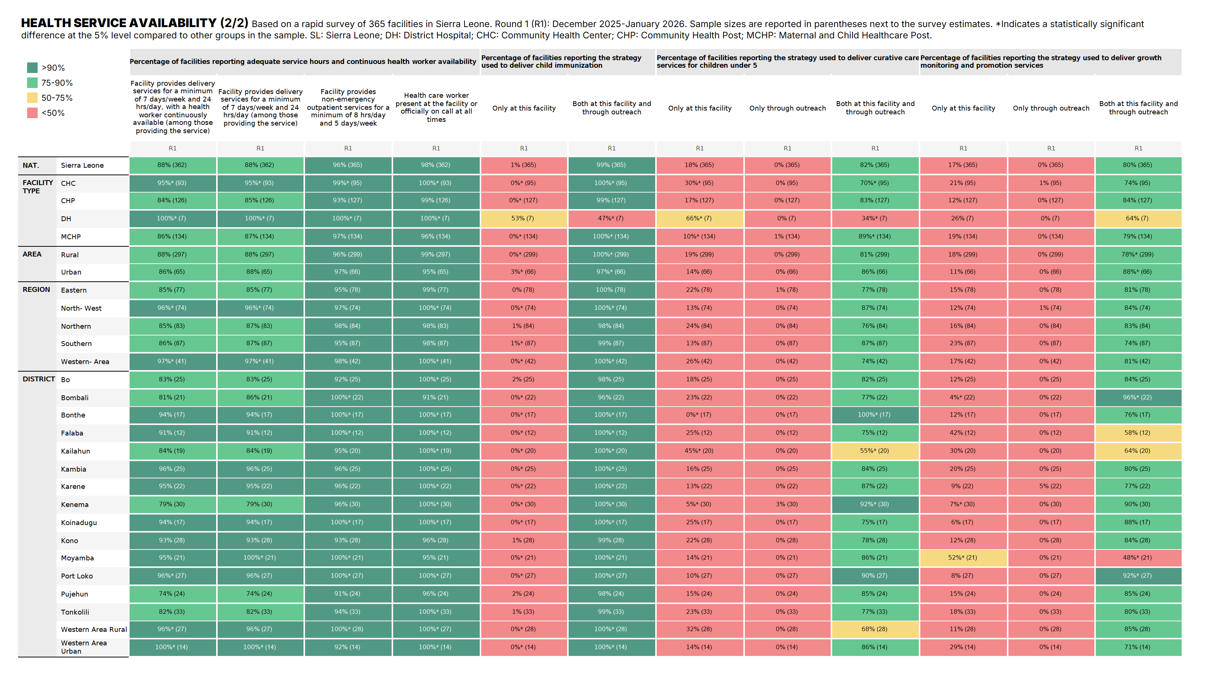

Slide 40
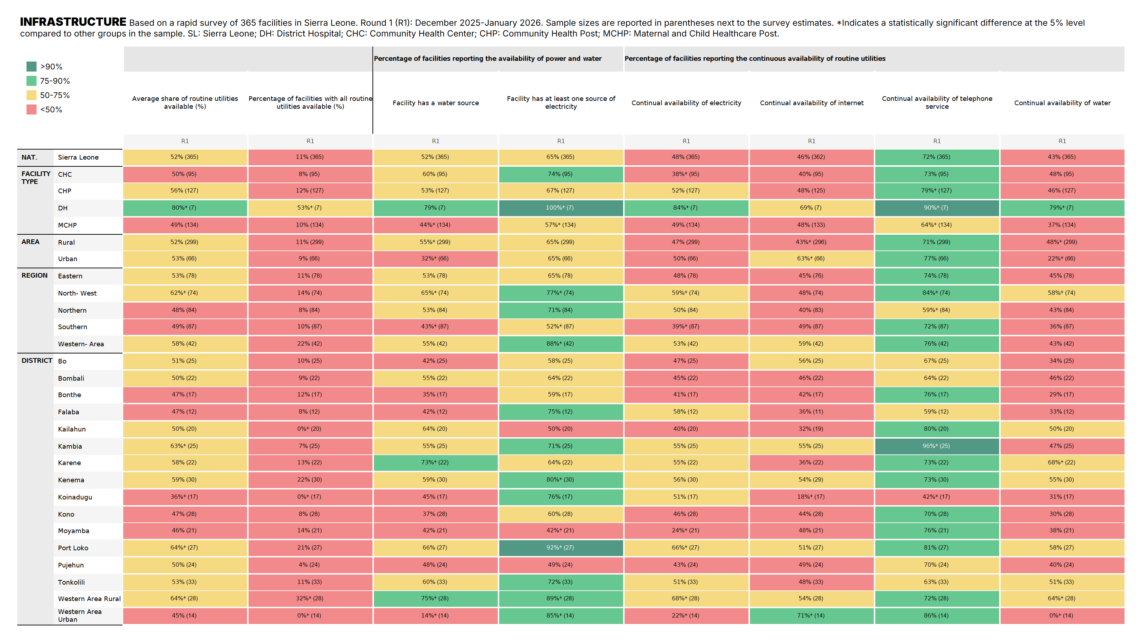

Slide 41
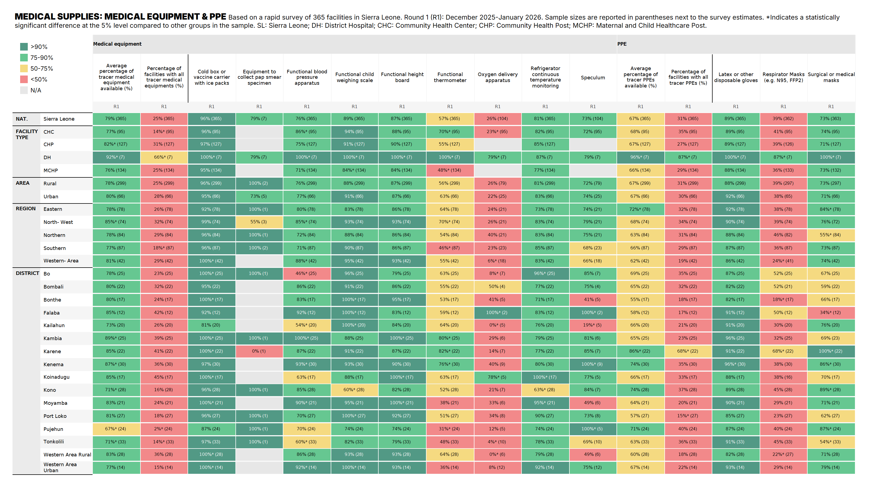

Slide 42
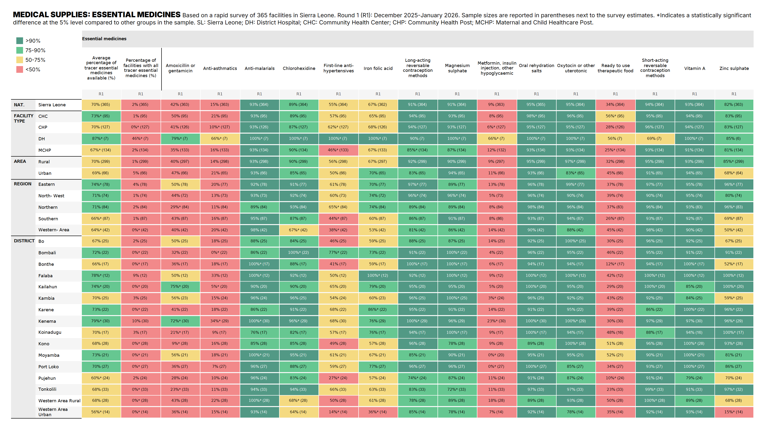

Slide 43
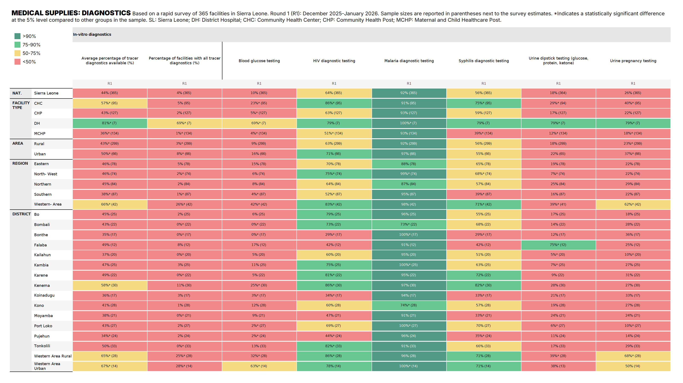

Slide 44
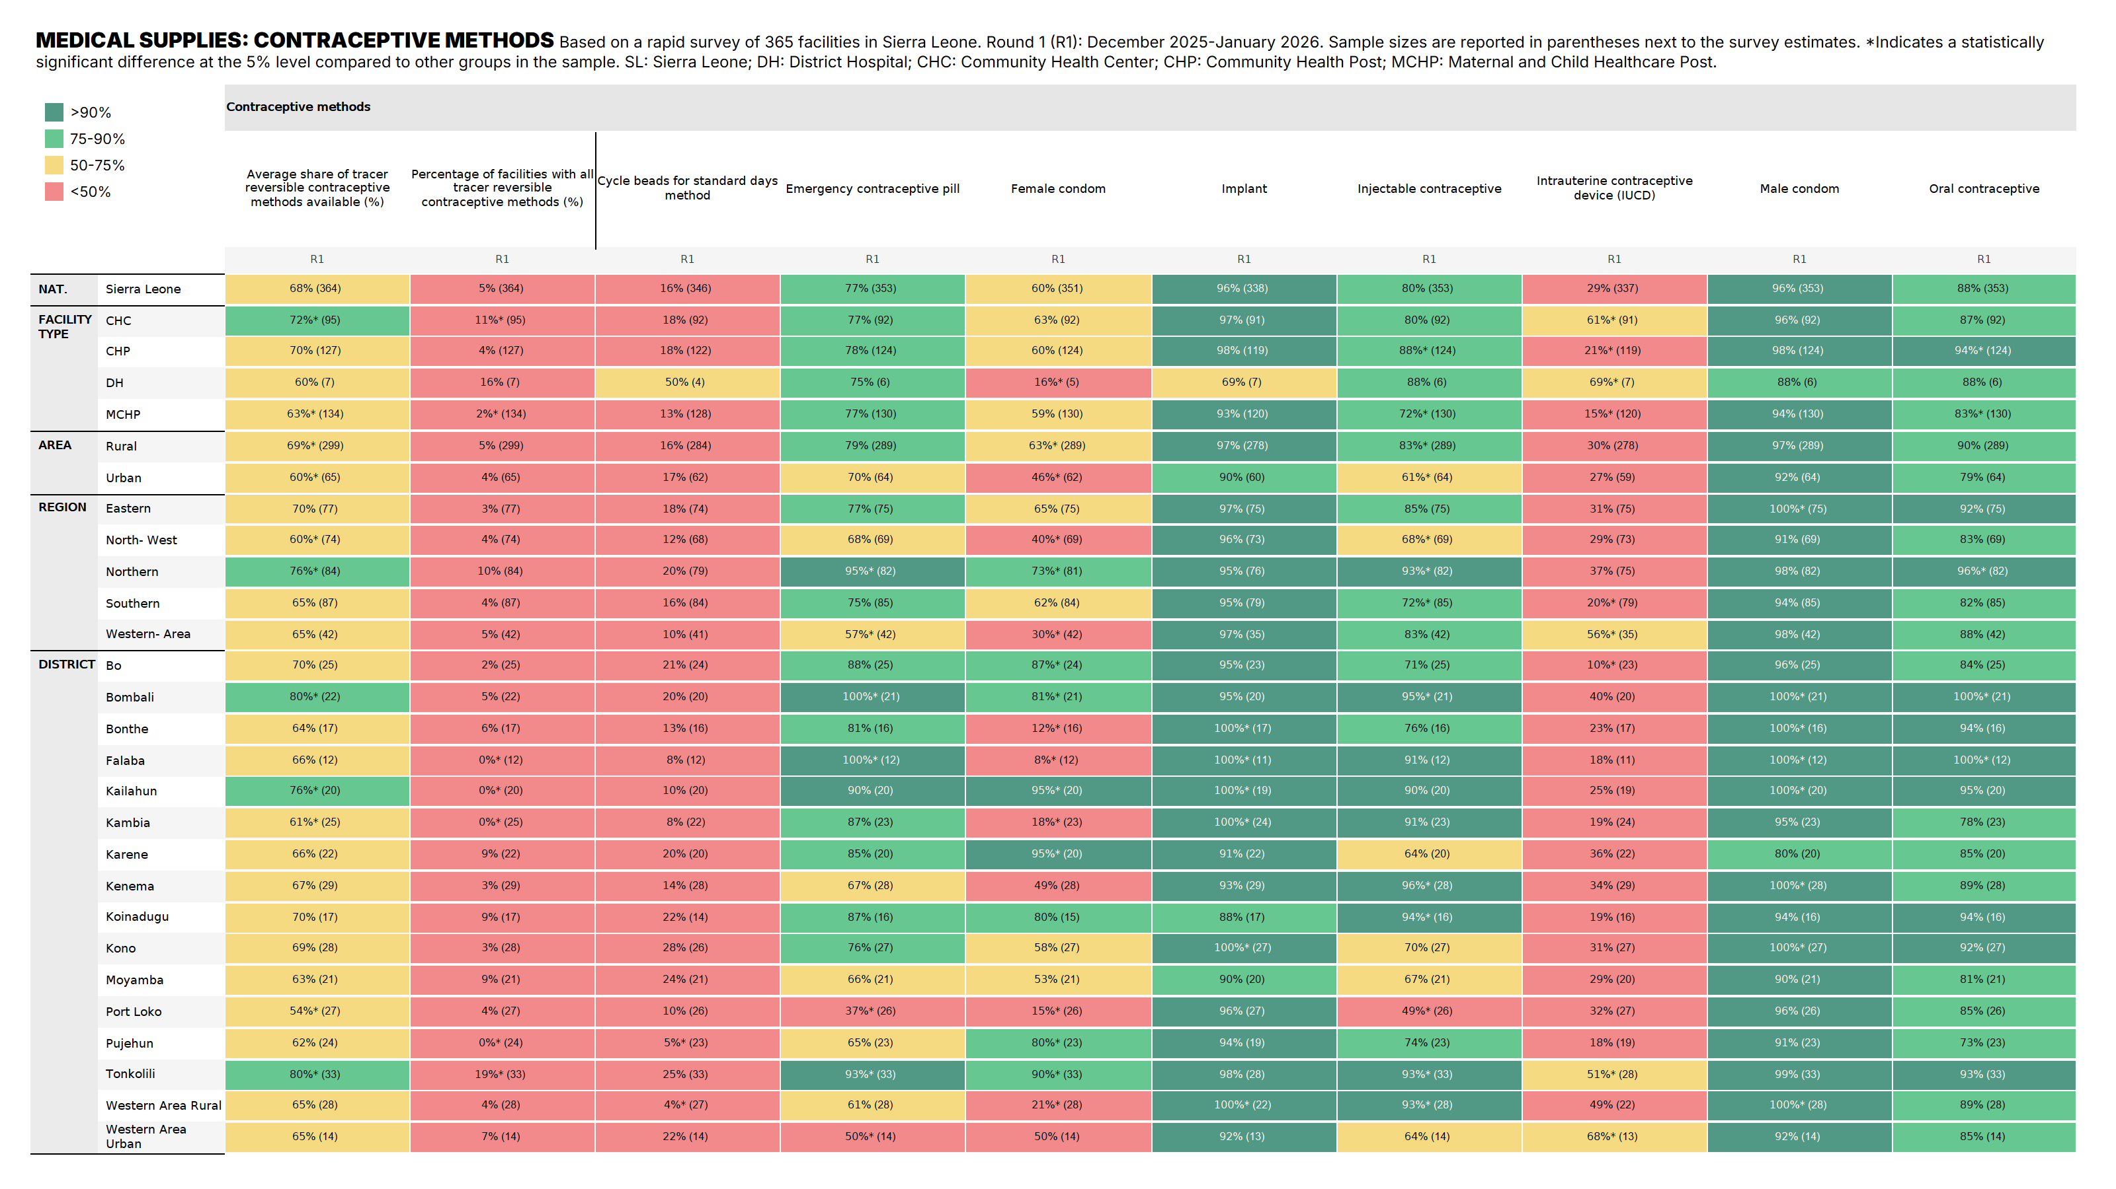

Slide 45
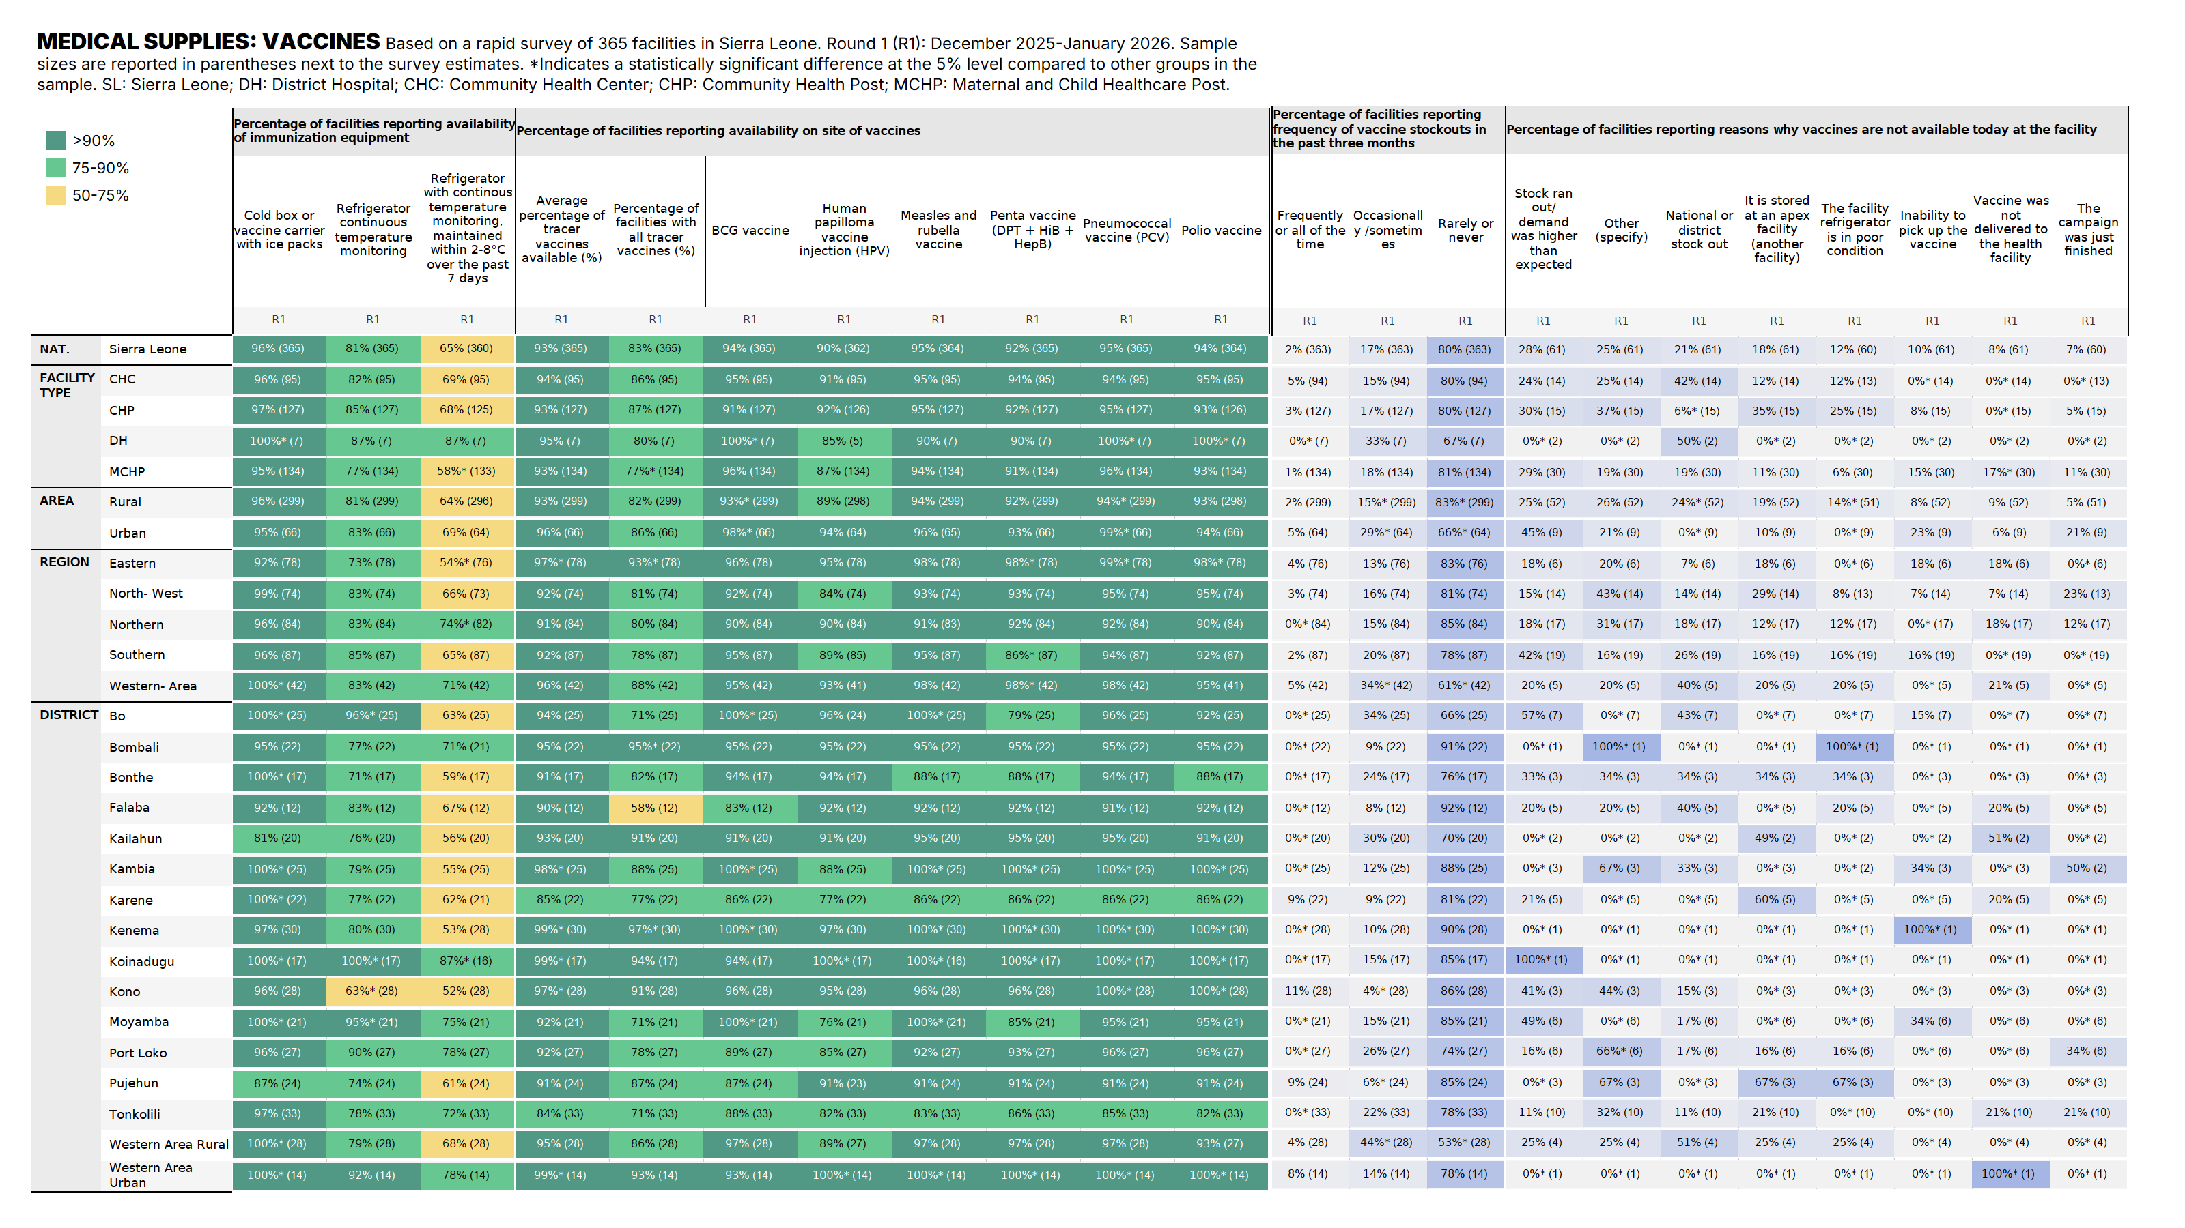

Slide 46
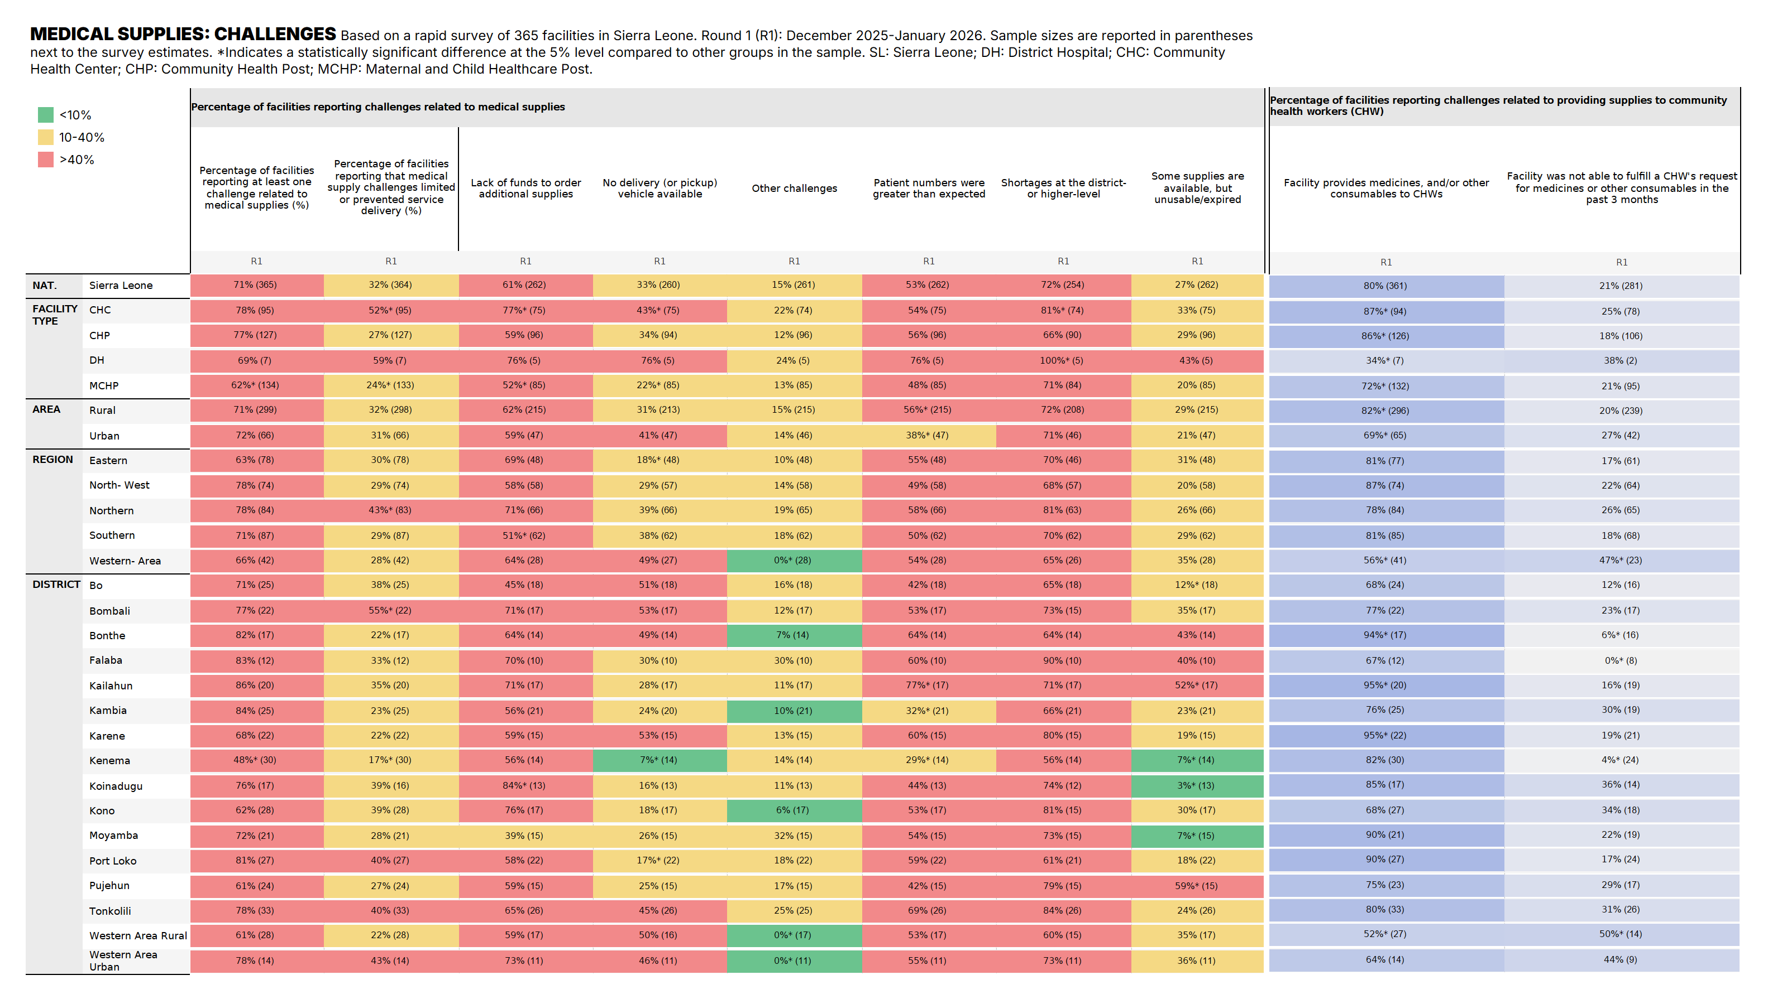

Slide 47
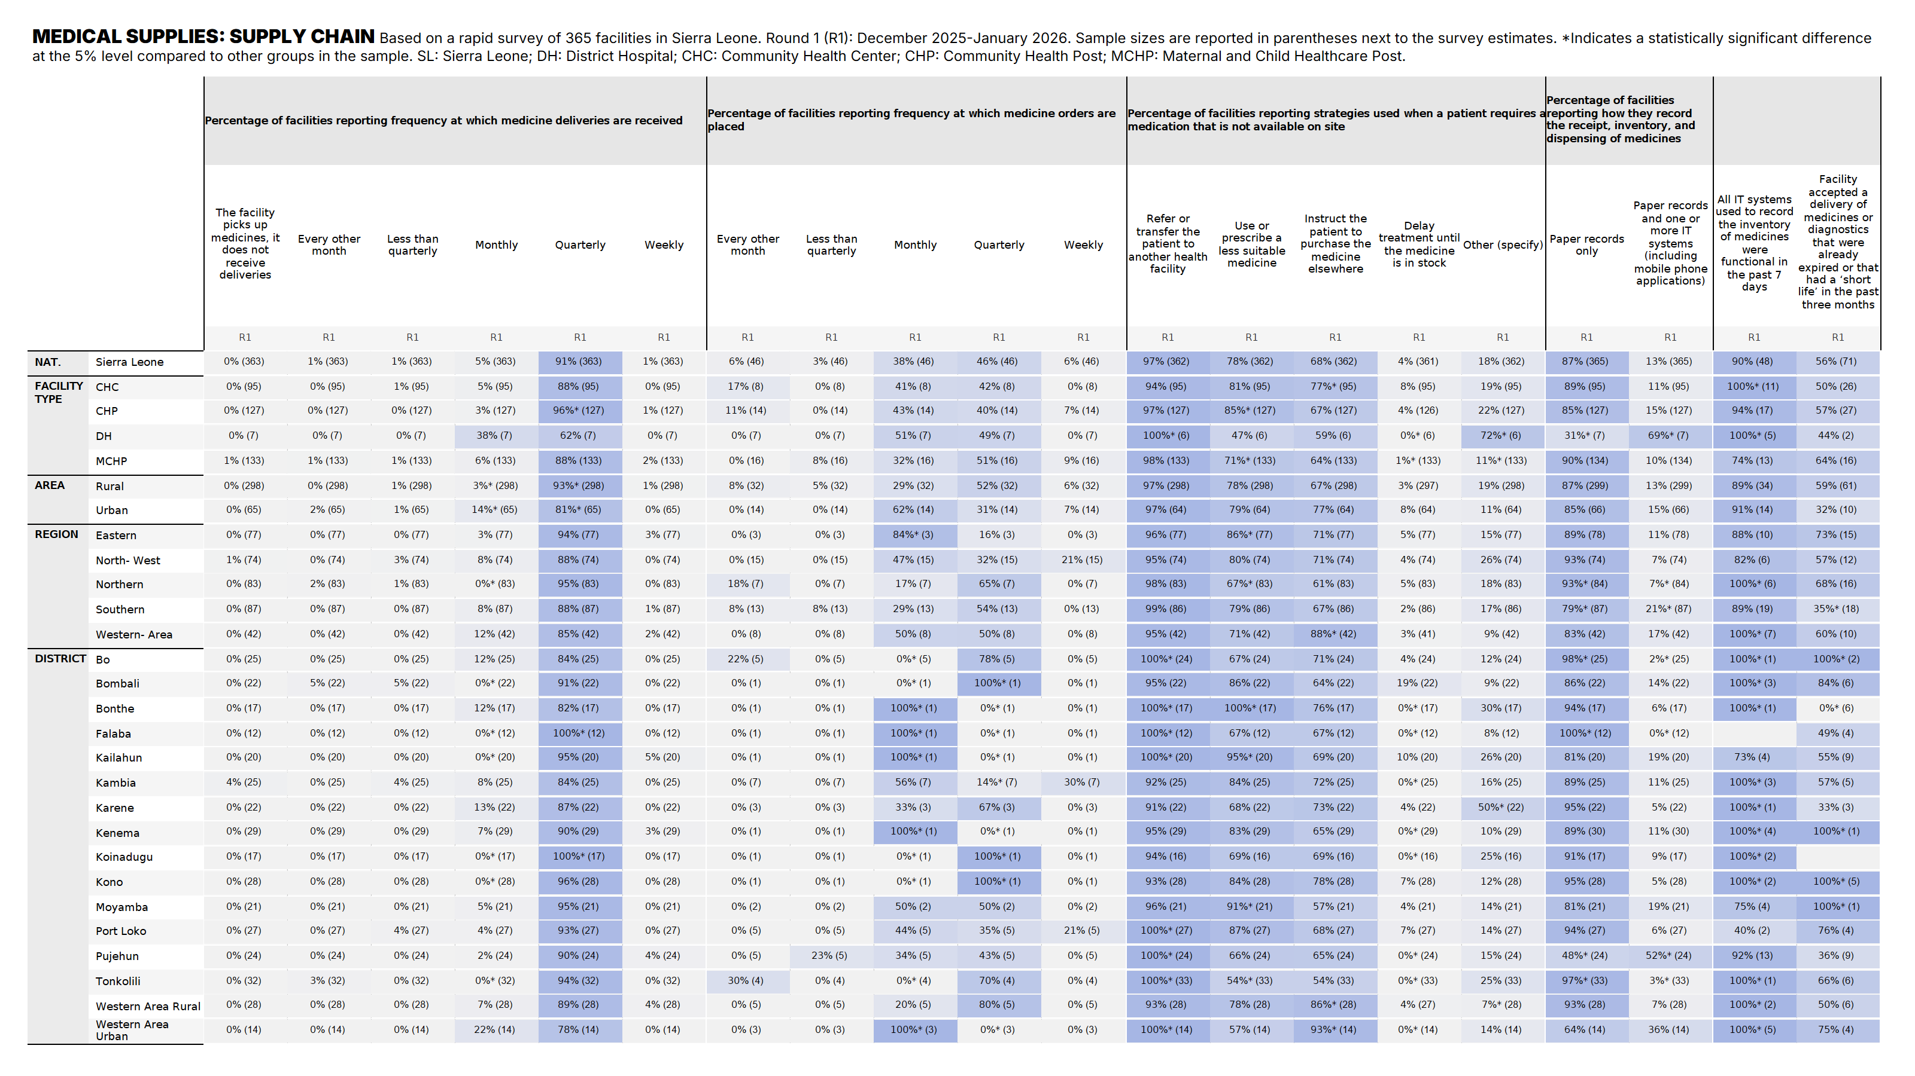

Slide 48
Contents
Overview
Primary Health Care (PHC) Assessment
Service Delivery Challenges
Service Availability
Infrastructure
Medical Supplies
Annex
Methodology Annex
Annex Tables
Background on the FASTR initiative
@ UNICEF Sierra Leone/2016/Mason

Slide 49

The goal? Rapid cycle analytics accelerates improvements in RMNCAH-N outcomes by increasing the systematic use of data for decision making
In person surveys
In person surveys
Timely, rapid-cycle data
Year 1
Year 5
Continuous data use
Notes:
What is the goal of FASTR? The idea of FASTR is that rapid-cycle analytics can accelerate improvements in reproductive, maternal, newborn, child, adolescent health, and nutrition outcomes by increasing the systematic use of data for decision-making. Currently, many countries rely on large-scale, in-person surveys that are conducted only every 4 to 5 years—or even less frequently. While those surveys remain important, the goal of FASTR is to complement them with more rapid, regular data collection. By generating timely insights between major surveys, we can better monitor progress, identify challenges, and adjust programs and policies in a more agile and responsive way.

Slide 50
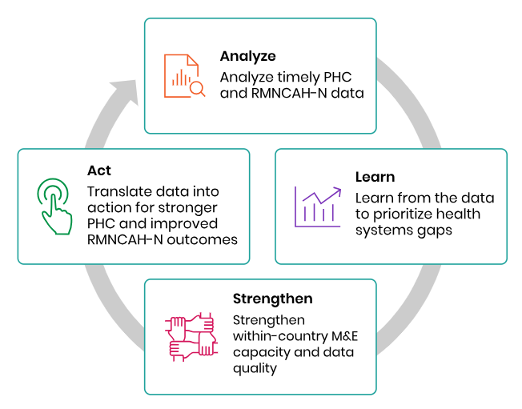
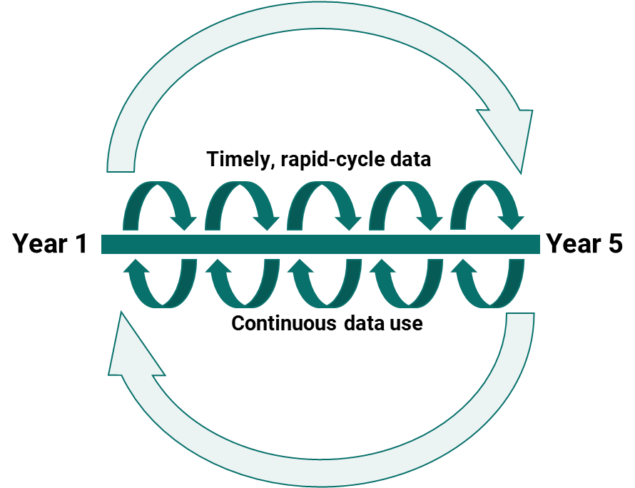
What is FASTR? An approach to catalyzing continuous ‘analyze, learn, strengthen, act’ cycles to drive the systematic use of timely data for decision making

Slide 51




How can this be achieved? Timely, rigorous, and low-cost approaches to monitoring PHC systems, underpinned by capacity building and data use support aligned with country demand and needs​
Routine RMNCAH-N Data
Leverage HMIS data to routinely monitor changes in the coverage of health services during reforms, shocks, or within vulnerable populations, while identifying and addressing data quality challenges.
Health facility Surveys
Understand service delivery gaps in PHC facilities and monitor their performance over time; understand the impact of health reforms or shocks on PHC performance.
Household & client surveys
Provide snapshots of health service utilization, foregone care, and community perceptions of service quality
Digging deeper with follow-up analyses
Gain a richer understanding of emerging health systems issues through rapid and adaptable mixed-methods approaches.
Build capacity + data use support Building within-country capacity for data collection, analysis, and use, with a focus on Ministry of Health leadership and partner alignment.
Find more details on FASTR’s rapid-cycle health facility surveys, including publicly available tools and resources, on our website.

Slide 52




Themes:
Rapid Health Facility Phone Surveys
11 survey modules based on WHO’s PHCMFI framework
Questions inspired by large-scale HHFA/ SARA, SPA et SDI
Assess service delivery constraints and readiness in primary health care (PHC) facilities
Support continuous monitoring and evaluation of reforms or projects to inform decision-making and enable rapid course correction
Improve timeliness, relevance, and cost-effectiveness of facility surveys as an adaptative management tool
INPUTS
STRUCTURES
Infrastructure
Human resources
Medical supplies
Financing
Leadership & coordination
Emergency Management, Preparedness and Response
PROCESSES
OUTPUTS
Community engagement
Quality improvement processes
Service availability
Resilience to shocks
Service delivery challenges
100% adaptable by countries

Slide 53

About FASTR I Access the FASTR resource repository
Contact us at fastr@worldbank.org

